Slide 1
Chapter 13: The Presidency
Review for Exam

Slide 2
The Presidents
Great Expectations
  Americans want a president who is powerful and who can do good: Washington, Jefferson, Lincoln, Roosevelt and Kennedy.
  But at the same time, they don’t want the president to get too powerful since we are individualistic and skeptical of authority.

Slide 3
The Presidents
Who They Are
  Formal Requirements:
    Must be 35 years old
    Must be a natural-born citizen
    Must have resided in U.S. for 14 years
  Informal “Requirements”:
    White, Male, Protestant (except one)
  All manner of professions, but mostly political ones (former state governors, for example)

Slide 4
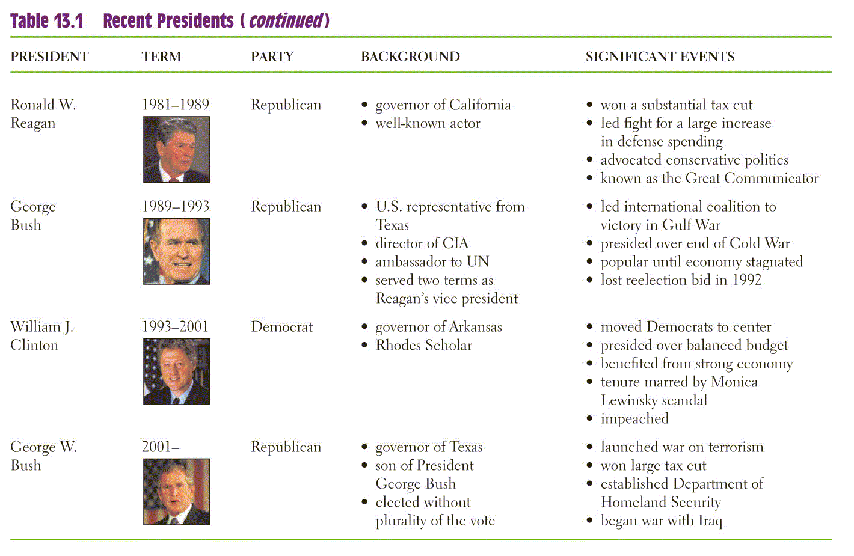
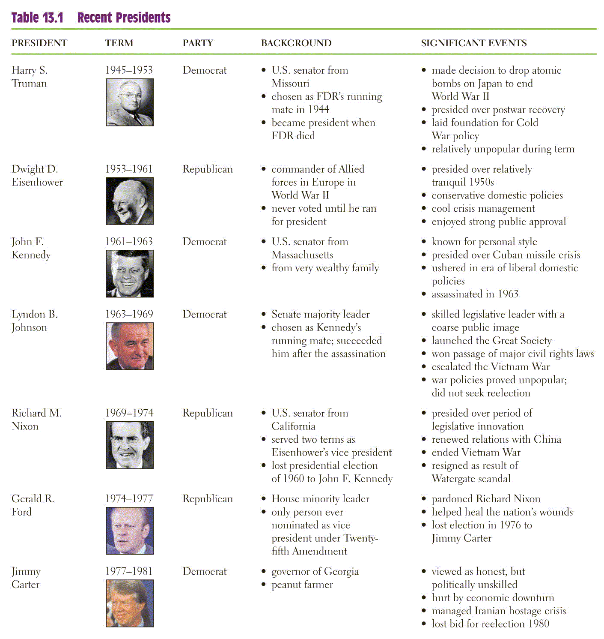
The Presidents

Slide 5
The Presidents
How They Got There
  Elections: The Normal Road to the White House
    Once elected, the president gets a term of four years.
    In 1951, the 22nd Amendment limited the number of terms to two.
    Most Presidents have been elected to office.

Slide 6
The Presidents
How They Got There
  Succession and Impeachment
    Vice-President succeeds if the president leaves office due to death, resignation, or removal.
    Impeachment is investigated by the House, and if impeached, tried by the Senate with the Chief Justice presiding.
    Only two presidents have been impeached: A. Johnson & Clinton - neither was convicted.
    The 25th Amendment clarifies what happens if the president becomes disabled.

Slide 7
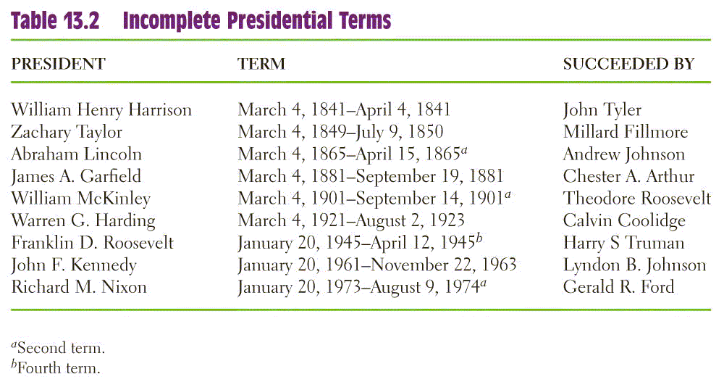
The Presidents

Slide 8
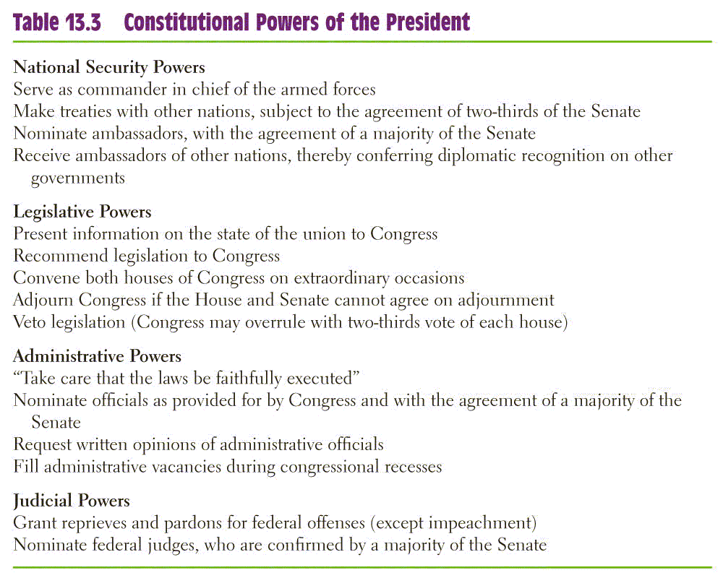
Presidential Powers

Slide 9
Presidential Powers
The Expansion of Power
  Presidents may develop new roles for the office
  Presidents may expand the power of the office
Perspectives on Presidential Power
  Through the 50’s & 60’s a powerful President was perceived as good.
  From the 70’s on, presidential power was checked and distrusted by the public.

Slide 10
Running the Government:
The Chief Executive
The Vice President
  Basically just “waits” for things to do
  Recent presidents have given their VPs important jobs
The Cabinet
  Presidential advisors, not in Constitution
  Is made up of the top executives of the Federal Departments, confirmed by the Senate

Slide 11
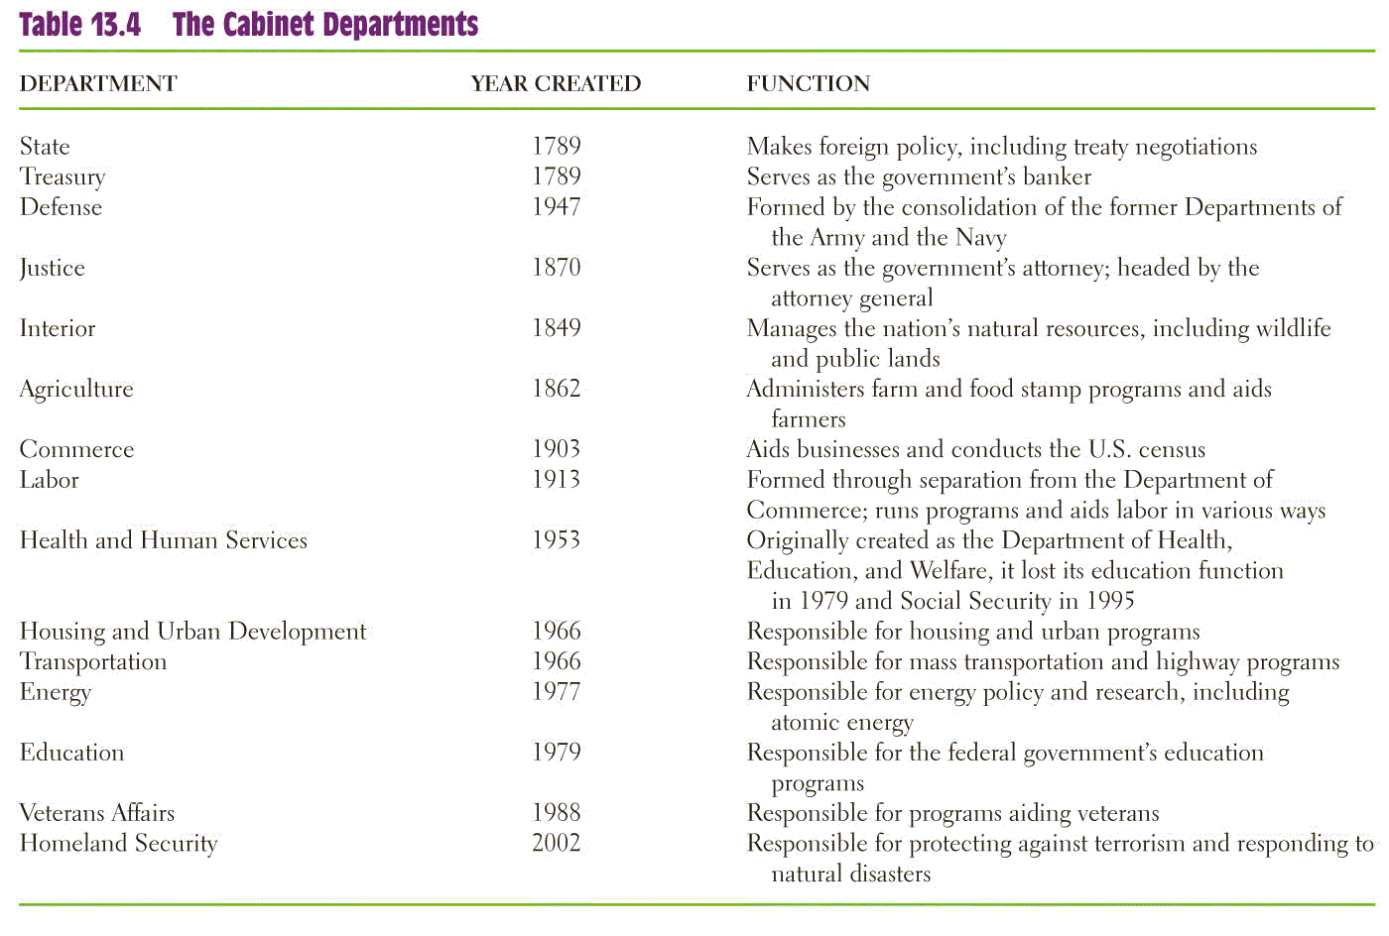
Running the Government: The Chief Executive

Slide 12
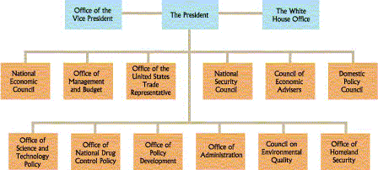
Running the Government:
The Chief Executive
The Executive Office
  Made up of several policymaking and advisory bodies
  Three principle groups: NSC, CEA, OMB

Slide 13
Running the Government:
The Chief Executive
The White House Staff
  Chief aides and staff for the president - some are more for the White House than the president
  Presidents rely on their information and effort
The First Lady
  No official government position, but many get involved politically
  Recent ones focus on a single issue

Slide 14
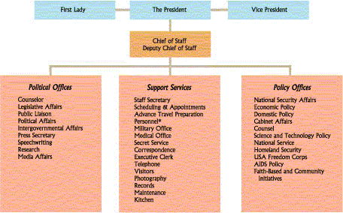
Running the Government: The Chief Executive
Principal Offices in the White House (Figure 13.2)

Slide 15
Presidential Leadership of Congress: The Politics of Shared Powers
Chief Legislator
  Veto: Sending a bill back to Congress with his reasons for rejecting it. Can be overridden.
  Pocket Veto: Letting a bill die by not signing it - only works when Congress is adjourned.
  Line Item Veto: The ability to veto parts of a bill. Some state governors have it, but not the president.
  Vetoes are most used to prevent legislation.

Slide 16
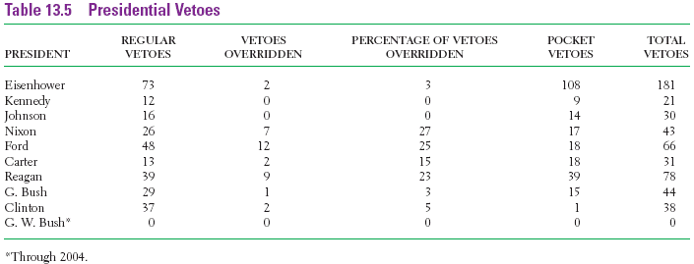
Presidential Leadership of Congress: The Politics of Shared Powers

Slide 17
Presidential Leadership of Congress: The Politics of Shared Powers
Party Leadership
  The Bonds of Party
    The psychological bond of being in the president’s party
  Slippage in Party Support
    Presidents cannot always count on party support, especially on controversial issues
  Leading the Party
    Presidents can offer party candidates support and punishment by withholding favors.
    Presidential coattails occur when voters cast their ballots for congressional candidates of the president’s party because they support the president.

Slide 18
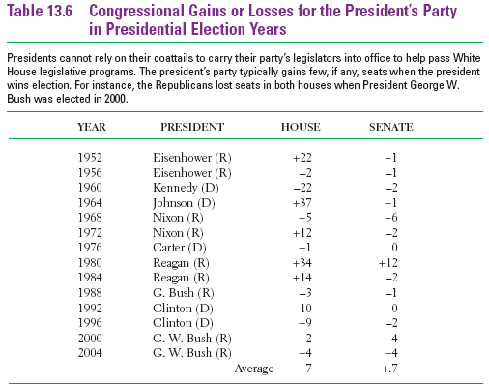
Presidential Leadership of Congress: The Politics of Shared Powers

Slide 19
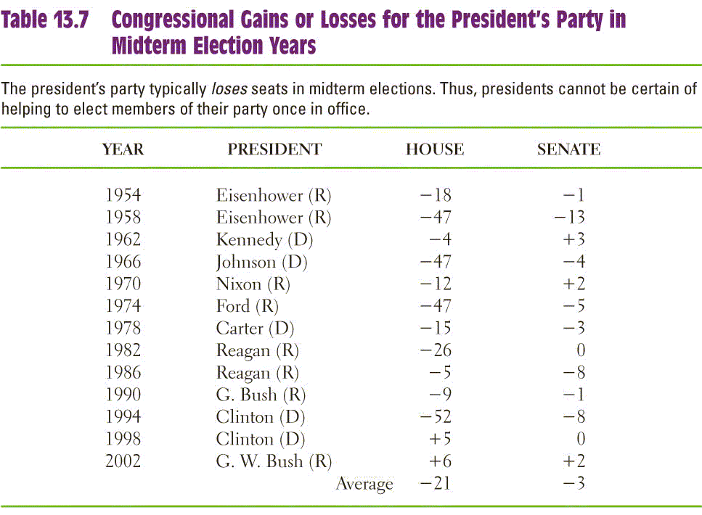
Presidential Leadership of Congress: The Politics of Shared Powers

Slide 20
Presidential Leadership of Congress: The Politics of Shared Powers
Public Support
  Public Approval
    Operates mostly in the background
    Public approval gives the president leverage, not command
  Mandates
    Perception that the voters strongly support the president’s character and policies
    Mandates are infrequent, but presidents may claim a mandate anyway

Slide 21
Presidential Leadership of Congress: The Politics of Shared Powers
Legislative Skills
  Variety of forms: bargaining, making personal appeals, consulting with Congress, setting priorities, etc.
  Most important is bargaining with Congress.
  Presidents can use their “honeymoon” period to their advantage.
  Nation’s key agenda builder

Slide 22
The President and National Security Policy
Chief Diplomat
  Negotiates treaties with other countries
  Treaties must be approved by the Senate
  Use executive agreements to take care of routine matters with other countries
  May negotiate for peace between other countries
  Lead U.S. allies in defense & economic issues

Slide 23
The President and National Security Policy
Commander in Chief
  Writers of the constitution wanted civilian control of the military
  Presidents often make important military decisions
  Presidents command a standing military and nuclear arsenal - unthinkable 200 years ago

Slide 24
The President and National Security Policy
War Powers
  Constitution gives Congress the power to declare war, but presidents can commit troops and equipment in conflicts
  War Powers Resolution was intended to limit the president’s use of the military - but may be unconstitutional
  Presidents continue to test the limits of using the military in foreign conflicts

Slide 25
The President and National Security Policy
Crisis Manager
  A crisis is a sudden, unpredictable, and potentially dangerous event.
  The role the president plays can help or hurt the presidential image.
  With current technology, the president can act much faster than Congress to resolve a crisis.
Working with Congress
  President has lead role in foreign affairs.
  Presidents still have to work with Congress for support and funding of foreign policies.

Slide 26
Power from the People:
The Public Presidency
Going Public
  Public support is perhaps the greatest source of influence a president has.
  Presidential appearances are staged to get the public’s attention.
  As head of state, presidents often perform many ceremonial functions, which usually result in favorable press coverage.

Slide 27
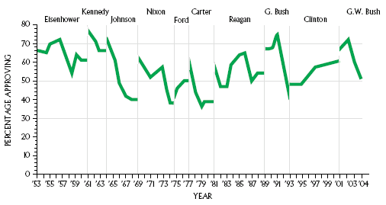
Power from the People:
The Public Presidency
Presidential Approval
  Receives much effort by the White House
  Product of many factors: predispositions, “honeymoon”
  Changes can highlight good / bad decisions

Slide 28
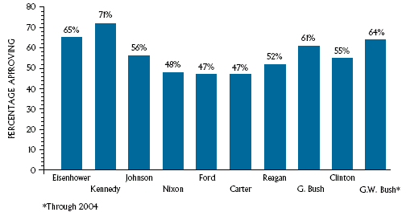
Power from the People: The Public Presidency
Average Presidential Approval for Entire Terms in Office (Figure 13.4)

Slide 29
Power from the People:
The Public Presidency
Policy Support
  Being an effective speaker is important.
  The public may still miss the message.
Mobilizing the Public
  The president may need to get the public to actually act by contacting Congress.
  Difficult to do since public opinion and political action are needed.

Slide 30
The President and the Press
Presidents and media are often adversaries due to different goals
Many people in the White House deal with the media, but the press secretary is the main contact person
Media are often more interested in the person, not the policies
News coverage has become more negative

Slide 31
Understanding the American Presidency
The Presidency and Democracy
  There are still concerns over the president having too much power.
  Others argue there are too many checks and balances on the president.
The Presidency and the Scope of Government
  Some presidents have increased the functions of government.

