Slide 1
Chapter 12: Section 1
Industrial Revolution in America
(Pages 386-391)

Slide 2
Industrial Revolution:
A time when the growth of industry changed the ways and places people lived.
The industrial revolution in Britain affected the Textile (cloth) industry
Before the Industrial revolution, families and artisan's had to had to make cloth and clothes in their homes or small shops

Slide 3
Factories:
New inventions allowed people to build factories to house large machines and many workers
The Factory system- allowed people and machines to work together as efficiently as possible to create large amounts of a product

Slide 4
Revolutionary inventions:
Page 387

Slide 5
Spinning jenny:
Invented by James Hargreaves
Spun many threads at a time to expedite work
Improved by Richard Arkwright
Created a water frame that used water to power more spindles and produce thread faster
Edmund Cartwright made it steam powered

Slide 6
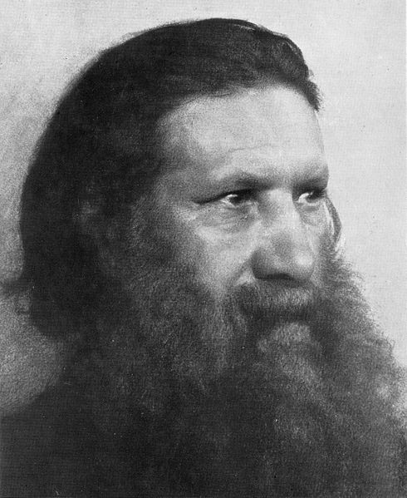
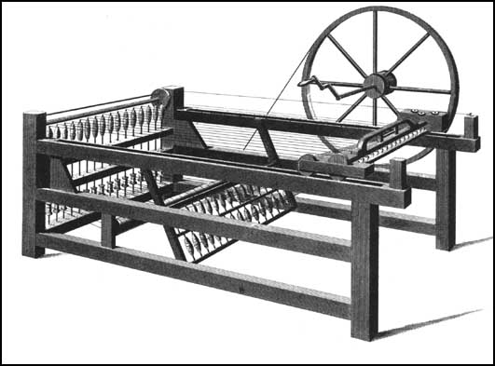
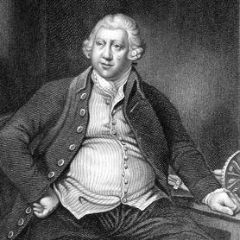
Richard Arkwright
James Hargreaves

Slide 7
Cotton Gin
Invented by Eli Whitney
Made to remove the seeds from cotton
Did the work of up to 50 people

Slide 8
Steam power
James Watt and Oliver Evans worked with the steam engine to help make its use more practical
Using steam to power machinery reduced the need for water power
Thus, people could now build factories away from rivers

Slide 9
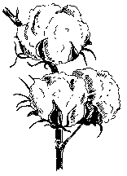
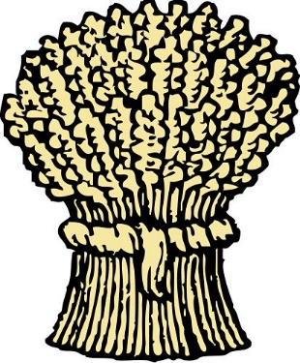
Industry in the United States
Before the industrial revolution America produced mainly raw materials like:
Cotton
Lumber
Iron
Wheat
Artisans such as carpenters used hand tools to make their products

Slide 10
Before the American Revolution:
America had depended on Britain for manufactured goods
British regulations had discouraged American industry from competing

Slide 11
After independence:
Americans were free to share profits of the industrial revolution
Some states offered rewards to people from Britain who would bring their knowledge of machines and industry to America

Slide 12
Samuel Slater
A 21 year old apprentice in a textile mill
Memorized the design of the machines in Britain
Traveled to America in disguise and helped Mosses Brown (the owner of a cotton mill in Rhode island)

Slide 13
The Lowell Landmark
Francis Cabot Lowell built a power loom
Made it so that you could create cloth from cotton in one process in one building

Slide 14
Interchangeable Parts
Parts that are exactly alike
Revolutionized gun-making
Some workers would cut metal
Others put the parts together
Giving each worker a few simple jobs to do is called division of labor
Division of Labor, interchangeable parts and new manufacturing methods help create mass production of goods possible

Slide 15
Growing Cities
In 1810 about 90% of Americans still lived on farms
The industrial revolution allowed cities to grow
Cities offered:
more job opportunities
better chances for education
Libraries
Theaters

Slide 16
Problems with cities
Clean water
Fire protection
Public health
Over crowded living conditions
Run down homes

