Slide 1
Chapter 12 The Industrial Revolution

Slide 2
Section 1 The Industrial Revolution in America

Slide 3
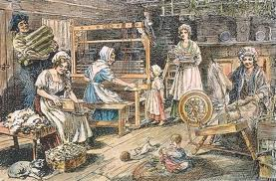
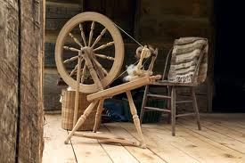
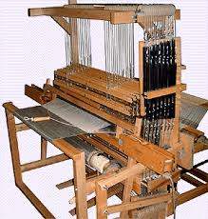
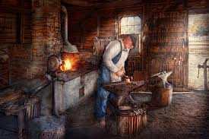
Before Industrialization
Early 1700s – Europe – farmers
Made things by hand
Clothing
Spinning wheel – cotton or wool – thread
Hand loom – cloth
Merchants – sold for profit
Skilled workers owned shops –
Ex: blacksmiths

Slide 4
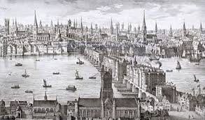
Changes in Great Britain
Cities and populations grew
Overseas trade expanded
Not enough goods produced
Need for efficiency
Industrial Revolution
Rapid growth
Machines for manufacturing and production

Slide 5
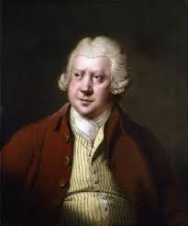
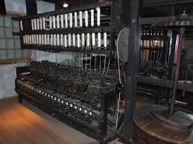
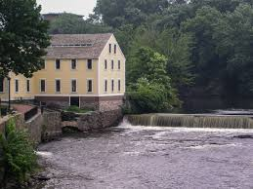
The Textile Industry
Textiles = cloth items
Hand spinning and weaving
Richard Arkwright
Water Frame – lowered cost, increased speed
Water power – rivers
Textile mills = factories

Slide 6
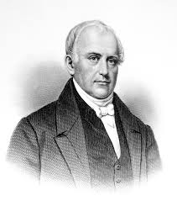
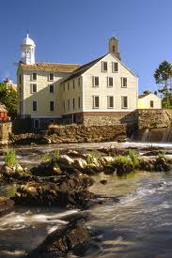
Samuel Slater
British Parliament
Illegal for mechanics or machine
plans to leave the country
Slater – memorized designs – arrives in America
Moses Brown – owned textile business in New England
Smith Brown and William Almy – partner with Slater
Pawtucket, Rhode Island – 1st mill

Slide 7
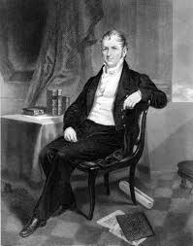
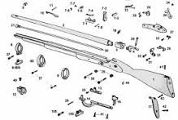
Eli Whitney
U.S. government – need for muskets
Made by hand – no 2 parts alike – took time and skill
Needed better technology
Eli Whitney – mass producing guns – water power
Interchangeable parts – identical – easier to assemble and replace
Mass production – large numbers

Slide 8
Manufacturing Grows Slowly
Land was plentiful and cheap
People would choose to own their own farm
American manufacturers could not compete with the British
Only a few industries thrived:
Cotton goods, flour milling, weapons, and iron production

Slide 9
Manufacturing Takes Off
The War of 1812
Americans could no longer buy manufactured goods from Europe
Began buying American
Factories grew
The U.S. had become to dependent on foreign goods
Period of Industrial growth
Higher tariffs on imported goods

Slide 10
Section 2 Changes in Working Life

Slide 11
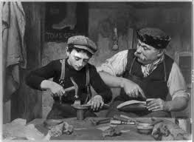
Mills Change Workers’ Lives
Lack of workers
Apprentices – young men who worked for several years to learn a trade
Given simple work
Grew tired and frequently left

Slide 12
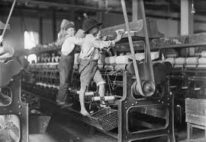
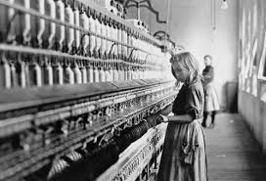
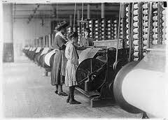
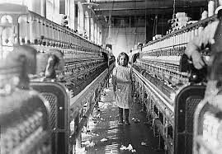
The Rhode Island System
Samuel Slater
Began hiring entire families
Moved to the mills
Low cost
Children working was common
Worked on farms
Machines made tasks easy for children to do
Could pay children less than adults

Slide 13
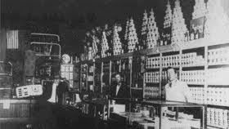
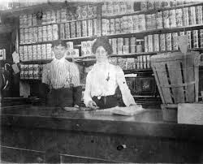
The Rhode Island System
Samuel Slater built housing for families
Provided a company store
Started paying workers with store credit
Small payments over time
Workers had to buy necessities from the company – no cash
Allowed Slater to reinvest his money in his business

Slide 14
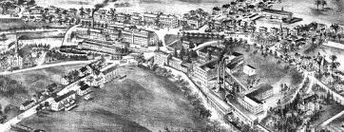
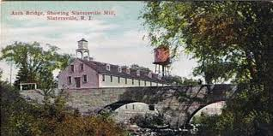
Mill Towns
Slatersville – one of the earliest mill towns
2 workers’ houses
Company store
Owner’s house
Slatersville Mill
Mechanics and dam builders
Small businesses – tailors, butchers, small workshops
Largest and most modern of its time

Slide 15
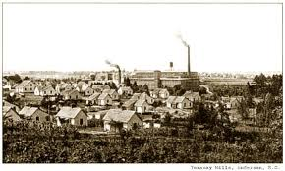
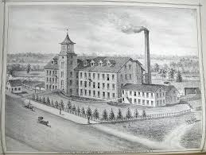
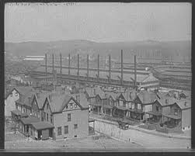
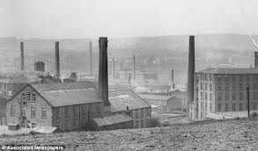
Mill Towns
Other factories copied Slater’s system
Advertised for families
Sent recruiters to poor communities
Welcome opportunity for many people to earn money and learn a new skill

Slide 16
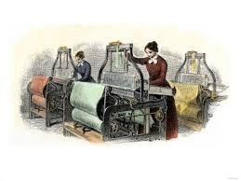
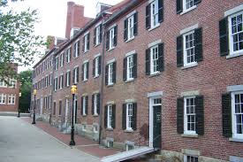
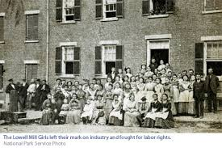
The Lowell System
Francis Cabot Lowell
Developed a different system
Employed young, unmarried women from local farms
Lived in boardinghouses
Lowell’s first textile mill opened in Waltham, Massachusetts in 1814

Slide 17
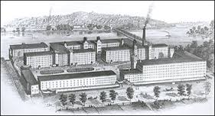
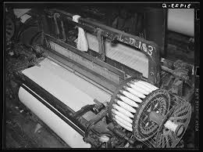
Lowell, Massachusetts
Lowell built a larger mill in 1822
Town of Lowell
Clean factories and neat boardinghouses
New machinery
Machines that could spin thread as well as weave cloth

Slide 18
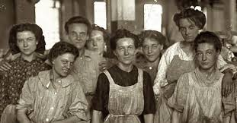
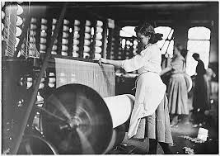
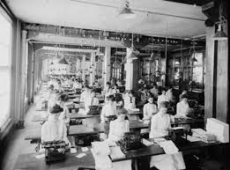
Lowell, Massachusetts
The Lowell Girls
$2-$4 per week
$1.25 for room and board
Attracted many young women
Worked for about 4 years
Spent free time taking classes and forming women’s clubs
Hard work – long days – 12-14 hours
Bells kept workers under control
Health problems – cotton dust

Slide 19
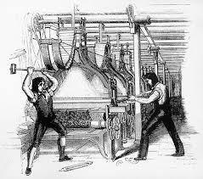
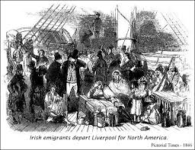
Workers Organize
Craftspeople – made goods by hand
Felt threatened by factories
Luddites – England – attacked factories
Competition for work led to lower wages
Immigration – 1840s Irish Potato Famine – willing to work for less pay
Panic of 1837 – unemployment – competition for jobs
50,000 people in New York City lost their jobs

Slide 20
Trade Unions
Skilled workers faced low wages and feared losing their jobs
Formed trade unions – tried to improve pay and working conditions
Unskilled workers also formed trade unions
Employers did not want to hire union workers
Demanded higher wages – more expensive
Trade unions would go on strike – stop working until their demands were met
Most early strikes were unsuccessful
Courts and police supported the companies

Slide 21
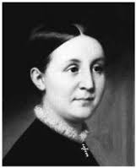
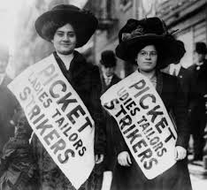
Labor Reform
Trade unions wanted to improve the lives of workers
Attempted to publicize the struggles of factory workers
Sarah G. Bagley – formed the Lowell Female Labor Reform Association in 1844
2 Goals:
1- Influence the Massachusetts legislature to investigate working conditions
2- Obtain a 10 hour workday
Passed out pamphlets and petitions

Slide 22
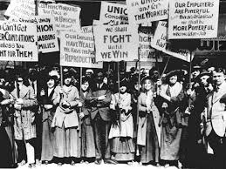
Labor Reform
In 1845 Sarah G. Bagley was elected vice-president of the New England Working Men’s Association
Unions faced opposition from business owners
Over time the unions got what they wanted
Connecticut, Maine, New Hampshire, Ohio, and Pennsylvania passed 10 hour workdays
Continued to fight for work reforms and an end to child labor

Slide 23
Section 3 The Transportation Revolution

Slide 24
Trade and Daily Life
Transportation Revolution:
A period of rapid growth in the speed and convenience of travel
Created a boom in business
Reduced shipping time and costs
Improved travel

Slide 25
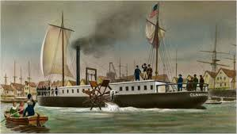
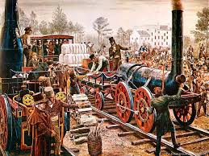
Trade and Daily Life
2 new inventions:
Steamboat
Steam-powered trains (locomotives)
Enabled goods, people, and information to travel quickly and efficiently

Slide 26
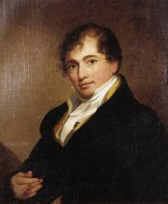
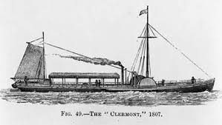
Steamboats
Robert Fulton
1st steamboat tested in France – 1803
The Clermont – 1st full-sized commercial steamboat
Tested the Clermont on the Hudson River in 1807
Increased demand for steamboat ferry service

Slide 27
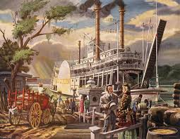
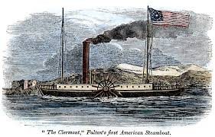
Steamboats
Well suited for river travel
No longer had to rely on wind power
Allowed for goods to move quickly – increased trade and profits
Transportation of passengers across the Atlantic Ocean

Slide 28
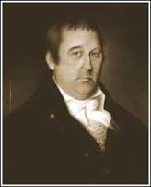
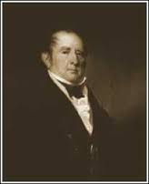
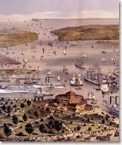
Gibbons v. Ogden
Conflict over waterway rights
Aaron Ogden sued Thomas Gibbons for operating steamboats in waters that he claimed he owned
Gibbons did not have a state license to operate in New York
Claimed his federal license gave him the right to use New York waterways

Slide 29
Gibbons v. Ogden
The case went to the Supreme Court in 1824
Favored Gibbons’ claim and federal license
Reinforced the federal government’s authority to regulate trade between states
Led to greater trade and shipping

Slide 30
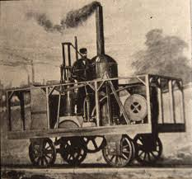
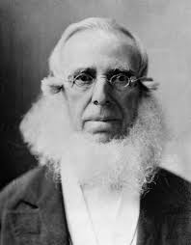
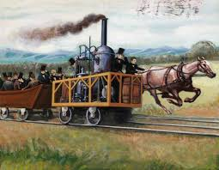
American Railroads
Steam-powered trains were first developed in Great Britain in the early 1800s
Became popular in the U.S. in the 1830s
Peter Cooper
Small and powerful locomotive – Tom Thumb
Raced against a horse-drawn railcar
The Tom Thumb broke down and lost the race, but the race displayed the power of locomotives

Slide 31
American Railroads
Railroads soon became popular
By 1840, 2,800 miles of track had been laid
Railroad companies faced many challenges
Steep mountains, tight curves, bridges over rivers
Built tracks quickly and cheaply – unsafe and didn’t last long
By 1860, 30,000 miles of track linked almost every city in the East
Led to an economic boom

Slide 32
The Impact of Railroads
Railroad companies became some of the most powerful businesses in the country
Opened up markets for manufacturers and farmers
Standard time zones – uniform train schedules

Slide 33
Travel
Increased passenger travel – reduced travel time
Thrilling and impressive
20 miles per hour
Sense of adventure
Dangerous tracks – engineers traveled too fast – crashes

Slide 34
The Transportation Revolution Brings Changes
Access to markets and products
Led to population growth – towns and cities at railroad junctions
Transportation hubs – Chicago – linked the Midwest to the East and South
Most railroads were located in the North – economic growth and prosperity

Slide 35
Coal
Wood was the early source of fuel for trains, as well as heating, cooking and light
Burned in the firebox of a locomotive to boil water and produce steam
The steam pushed pistons which were connected to rods that turned the wheels
Expensive and inefficient
Coal began to replace wood

Slide 36
Coal
Coal mining industry in Pennsylvania, West Virginia, and Illinois
New coal mining towns
Environmental effects – deep gashes in earth – air and water pollution

Slide 37
Steel
The invention of steel increased the demand for coal
Smelting process – heating iron ore to high temperatures – coal was used to fire the furnaces
Steel was much stronger than iron
Used in construction, machinery, railroad tracks

Slide 38
Steel
Increase in demand for steel increased the need for more railroads
Transported steel
Steel improved farming
Steel tools and machines – more crops
Railroads transported harvests

Slide 39
Logging
Towns and population grew – increased the need for wood – houses and furniture
Newspaper publishing increased – demand for paper
Led to deforestation

Slide 40
Section 4 More Technological Advances

Slide 41
The Telegraph
Samuel F. B. Morse
Perfected the telegraph
Studied electricity and magnetism
Sent information over wires across great distances
Sent pulses, or surges, of electric current through a wire

Slide 42
The Telegraph
The operator tapped the telegraph key that controlled the length of each pulse
Changed into clicking sounds
Dot = short click; Dash = long click
Alfred Lewis developed Morse Code
Different combinations of dots and dashes represented each letter of the alphabet
SOS = ••• – – – •••

Slide 43
The Telegraph
Telegraph wires followed the railroads
Telegraph offices in train stations
1st Transcontinental line in 1861

Slide 44
Steam Power and New Factories
Factories began using steam power
Factories could be built almost anywhere
Companies built factories close to cities and transportation centers
Supply of workers and lower shipping costs
Cities became the center of industrial growth
New and improved machine designs
Interchangeable parts
Precision machine tools

Slide 45
Improved Farm Equipment
John Deere
Developed a steel blade for plows
Much stronger than iron blades
Cyrus McCormick
Developed the mechanical reaper
A new harvesting machine that cut down wheat quickly and efficiently
Led to farmers harvesting huge crops
By 1860:
170 million bushels of wheat per year
Over 800 million bushels of corn per year

Slide 46
Home Improvements
Many inventions made life easier
The hand sewing machine
First invented by Elias Howe
Improved upon by Isaac Singer

Slide 47
Home Improvements
Other inventions:
Iceboxes
Iron cook-stoves
Matches
Safety pins

