Slide 1
Chapter 12 – The North
Section Notes
Video
The Industrial Revolution
in America
Changes in Working Life
The Transportation Revolution
More Technological Advances
Mass Transportation
Maps
Transportation Routes, 1850
History Close-up
A Mill Girl
Images
Textile Mill and Water Frame
Mississippi River Steamboats
The Steam Train
Samuel Morse
Quick Facts
Chapter 12 Visual Summary

Slide 2
The Industrial Revolution in America
The Big Idea
The Industrial Revolution transformed the way goods were produced in the United States.
Main Ideas
The invention of new machines in Great Britain led to the beginning of the Industrial Revolution.
The development of new machines and processes brought the Industrial Revolution to the United States.
Despite a slow start in manufacturing, the United States made rapid improvements during the War of 1812.

Slide 3
Main Idea 1: The invention of new machines in Great Britain led to the beginning of the Industrial Revolution.
Most people at the beginning of the 1700s were farmers, who made most of what they needed by hand.
Skilled workers, such as blacksmiths, carpenters, and shoemakers, made goods by hand in the towns.
People began using machines to make the manufacturing process more efficient.
The Industrial Revolution, a period of rapid growth using machines to make goods, arose in Great Britain in the mid-1700s.

Slide 4
Textile Industry
The first breakthrough in the Industrial Revolution was in how textiles, or cloth goods, were made.
Richard Arkwright, an Englishman, invented a spinning machine in 1769 called the water frame, which replaced hand spinning.
The water frame used flowing water as a source of power.
Could produce dozens of cotton threads at the same time
Lowered the cost of cotton production and increased the speed of textile production
Merchants built textile mills near rivers and streams.
Great Britain soon built the world’s most productive textile manufacturing industry.

Slide 5
Main Idea 2: The development of new machines and processes brought the Industrial Revolution to the United States.
Samuel Slater brought the secrets of textile mill manufacturing from Great Britain to the United States.
The textile industry arose in the Northeast, introducing the Industrial Revolution to the United States.

Slide 6
Manufacturing Breakthroughs
U.S. factories needed better technology, or tools, to manufacture muskets.
Inventor Eli Whitney developed musket factories using water-powered machinery.
Whitney introduced the idea of interchangeable parts, or parts of a machine that are identical, to make musket manufacturing easier.
Interchangeable parts sped up the process of mass production.

Slide 7
Main Idea 3: Despite a slow start in manufacturing, the United States made rapid improvements during the War of 1812.
Lower British prices on manufactured goods made it difficult for American manufacturing to grow.
American manufacturing was limited to cotton goods, flour milling, weapons, and iron products.
The War of 1812 cut off trade with Great Britain, allowing manufacturing in the United States to prosper and expand.
Americans realized that the United States had been relying too heavily on foreign goods.

Slide 8
Changes in Working Life
The Big Idea
The introduction of factories changed working life for many Americans.
Main Ideas
The spread of mills in the Northeast changed workers’ lives.
The Lowell system revolutionized the textile industry in the Northeast.
Workers organized to reform working conditions.

Slide 9
Main Idea 1: The spread of mills in the Northeast changed workers’ lives.
Factory jobs usually involved simple, repetitive tasks done for low pay.
Could not find workers because of the simple work and the fact that other jobs were available
The mill industry filled jobs by hiring whole families, and paying children low wages.
Built housing for workers and provided a company store
Samuel Slater’s strategy of hiring families and dividing factory work into simple tasks was called the Rhode Island system.

Slide 10
Main Idea 2: The Lowell System revolutionized the textile industry in the Northeast.
Francis Cabot Lowell created a new system of mill manufacturing in 1814, called the Lowell system.
The Lowell system involved
Employing young, unmarried women, who were housed in boardinghouses
Providing clean factories and free-time activities for its employees
Having mills that included both spinning thread and weaving in the same plant

Slide 11
Main Idea 3: Workers organized to reform working conditions.
Deteriorating Working Conditions
Employees worked 12-to-14 hour days in unhealthy conditions.
Craftsmen’s wages dropped in competition against cheap manufactured goods.
Wages of factory workers dropped as they competed for jobs.
Trade Unions Formed
Craftsmen formed trade unions to gain higher wages and better working conditions.
Factory workers also formed trade unions.
Labor unions staged protests called strikes, refusing to work until employers met their demands.

Slide 12
Labor Reform Efforts
Millworker Sarah G. Bagley helped lead the union movement in Massachusetts.
Bagley’s union campaigned to reduce the 12-to 14-hour workday to a 10-hour workday.
Union workers won some victories, as several states passed 10-hour workday laws.
In other states the workday remained long and child labor prevailed.

Slide 13
The Transportation Revolution
The Big Idea
New forms of transportation improved business, travel, and communications in the United States.
Main Ideas
The Transportation Revolution affected trade and daily life.
The steamboat was one of the first developments of the Transportation Revolution.
Railroads were a vital part of the Transportation Revolution.
The Transportation Revolution brought many changes to American life and industry.

Slide 14
Main Idea 1: The Transportation Revolution affected trade and daily life.
The 1800s gave rise to Transportation Revolution: period of rapid growth in new means of transportation
Transportation Revolution created boom in business by reducing shipping costs and time
Two new forms of transportation were steamboat and steam-powered trains
Goods, people, and information were able to travel rapidly and efficiently across the United States.

Slide 15
Main Idea 2: The steamboat was one of the first developments of the Transportation Revolution.
Robert Fulton invented the steamboat, testing the Clermont in 1807.
Steamboats increased trade by moving goods more quickly and more cheaply.
More than 500 steamboats were in use by 1840.
Gibbons v. Ogden (1824): The Supreme Court reinforced the federal government’s authority to regulate trade between states.
Gibbons argued that a federal license meant he could use New York waterways without another license.
The Supreme Court agreed with Gibbons.

Slide 16
Main Idea 3: Railroads were a vital part of the Transportation Revolution.
Steam-powered trains had been developed in Great Britain, but it took 30 years for the idea to catch on in the United States.
Peter Cooper raced his Tom Thumb locomotive against a horse in 1830, proving its power and speed despite losing because of a breakdown near the end of the race.
About 30,000 miles of railroads linked American cities by 1860.
The U.S. economy surged as railroads moved goods cheaply to distant markets.

Slide 17
Main Idea 4: The Transportation Revolution brought many changes to American life and industry.
People in all areas of the nation had access to products made and grown far away.
Railroads contributed to the expansion of the nation’s borders.
Cities and towns grew up along railroad tracks.

Slide 18
Impact of Railroads
Coal replaced wood as a source of fuel as trains grew bigger.
Railroads helped create the coal industry.
Coal, shipped cheaply on trains, became the main fuel in homes and in the emerging steel industry.
Railroads helped the lumber industry grow, leading to large-scale deforestation.
Railroads caused cities to grow, including Chicago, which became a transportation hub.

Slide 19
More Technological Advances
The Big Idea
Advances in technology led to new inventions that continued to change daily life and work.
Main Ideas
The telegraph made swift communication possible from coast to coast.
With the shift to steam power, businesses built new factories closer to cities and transportation centers.
Improved farm equipment and other labor-saving devices made life easier for many Americans.
New inventions changed lives in American homes.

Slide 20
Main Idea 1: The telegraph made swift communication possible from coast to coast.
In 1832, Samuel F. B. Morse perfected the telegraph—a device that could send information over wires.
The device did not catch on until the 1844 Democratic National Convention, when the nomination was telegraphed to Washington.
A Morse associate created Morse code to communicate messages over the wires.
Morse code turned pulses of electric current into long and short clicks.
Clicks, also called dots and dashes, were arranged in patterns representing letters of the alphabet.
The telegraph grew with the railroad; the first transcontinental railroad line was completed in 1861.

Slide 21
Main Idea 2: With the shift to steam power, businesses built new factories closer to cities and transportation centers.
The shift from water power to steam power allowed owners to build factories anywhere.
Factories were shifted closer to cities and transportation centers.
Cities became centers of industrial growth.

Slide 22
Main Idea 3: Improved farm equipment and other labor-saving devices made life easier for many Americans.
John Deere designed a steel plow in 1837 that replaced the less efficient iron plow.
Cyrus McCormick developed a mechanical reaper in 1831, which quickly and efficiently harvested wheat.
McCormick used a new method to encourage sales, advertising.
He also allowed people to buy on credit and provided repairs and spare parts for his machines.
These inventions allowed farmers to plant and harvest huge crop fields, helping the country prosper.

Slide 23
Main Idea 4: New inventions changed lives in American homes.
The sewing machine, invented by Elias Howe and improved by Isaac Singer, made home sewing easier.
Ice boxes and iron cookstoves improved household storage and preparation of food.
Mass-produced goods, such as clocks, matches, and safety pins, added convenience to households.

Slide 24
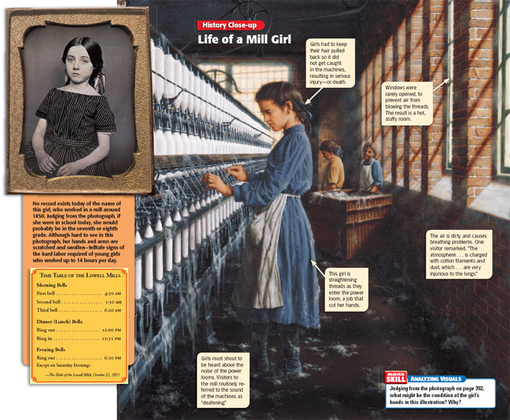

Slide 25
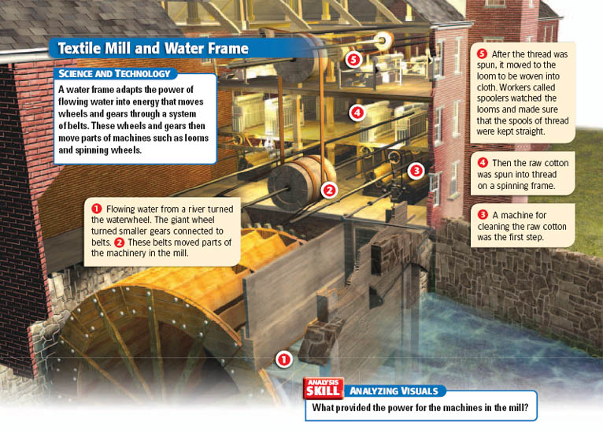

Slide 27
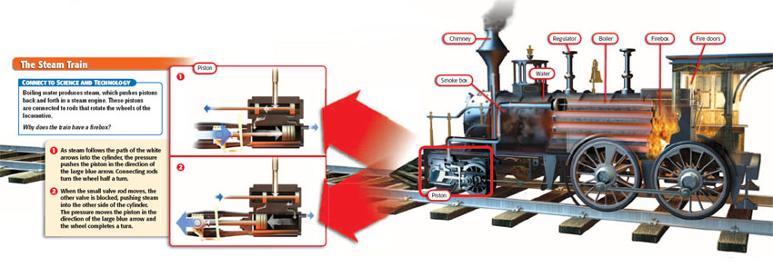

Slide 28
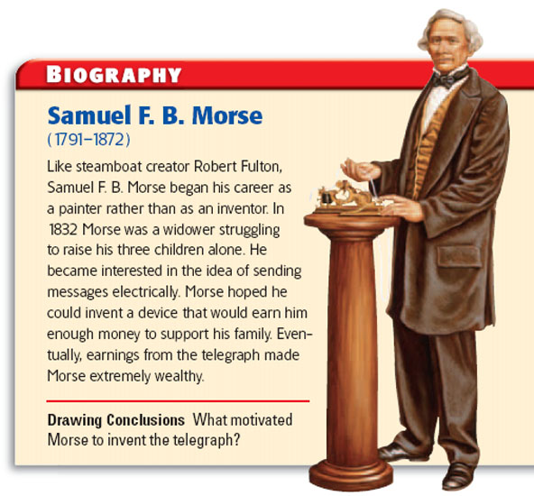

Slide 30
