Slide 1
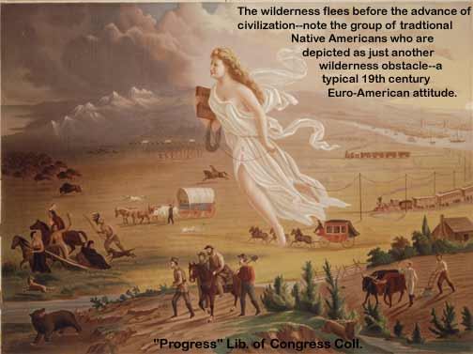
Chapter 11: Manifest Destiny Section 1: Trails to the West
“Our manifest destiny [is] to…possess the whole of the continent.”-
John O’Sullivan
This painting (circa 1872) by John Gast called American Progress, is an allegorical representation of the modernization of the new west. Here Columbia, a personification of the United States, leads civilization westward with American settlers, stringing telegraph wire as she sweeps west; she holds a school book as well. The different stages of economic activity of the pioneers are highlighted and, especially, the changing forms of transportation.

Slide 2
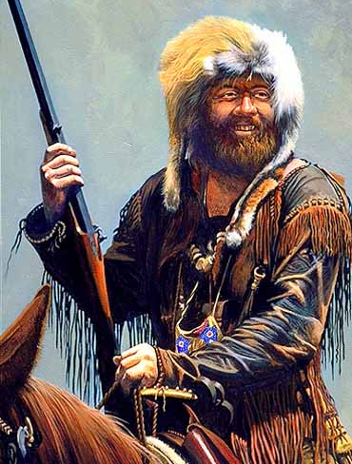
The West Was Really Beginning to Open Up in the Mid 1800’s
Some of the first white settlers in the west were often referred to as “mountain men”
These men were characterized by popular culture as independent, tough, adventurous, willing to take on anything.
Many of them were trappers – looking for animal skins to eventually send east to sell for profits.

Slide 3
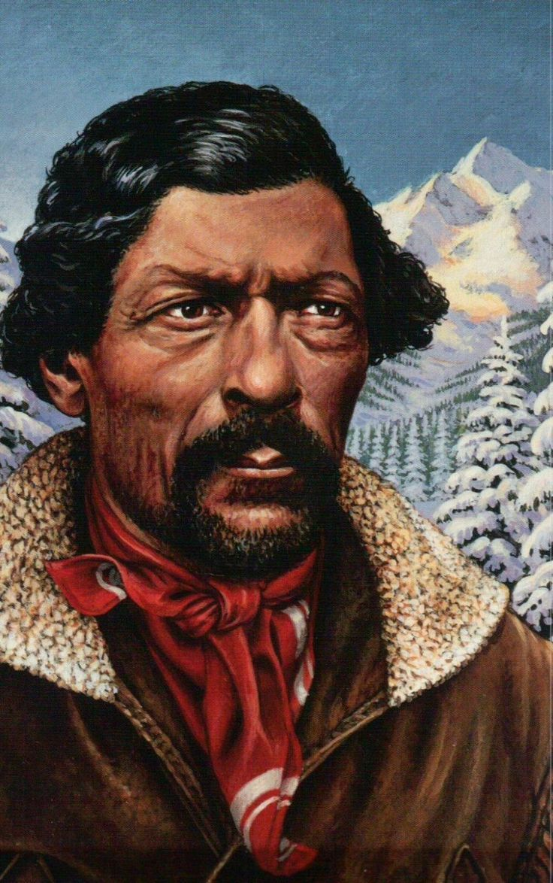
Mountain Man, Jim Beckwourth
Born into slavery and set free by his owner
Lived with the Native American tribe Apsáalooke for several years
Later worked as an army scout and gold prospector
Discovered a mountain pass that became the route into present day northern California
This pass is still called Beckwourth Pass

Slide 4
Mountain Men opened the west for future pioneers

Slide 6
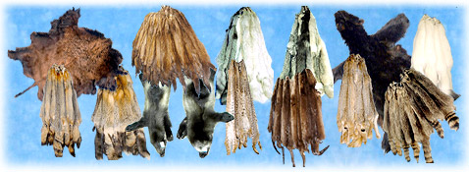
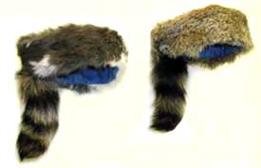
They spent their time trapping animals.
They agreed to meet traders from the east once in a while for future business opportunities.
These meetings were called the “rendezvous” system.
(a rendezvous is a meeting)
They would then get supplies to last them while they continued to hunt.

Slide 7
Mountain Men and Native Americans would meet at a rendezvous to trade for goods.

Slide 8
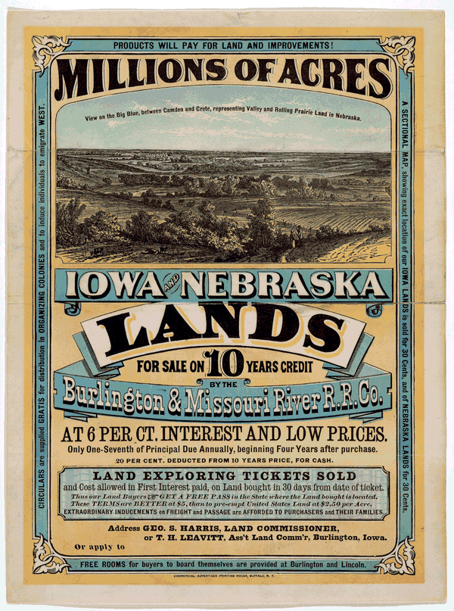
The next wave of people went west because of the opportunity to claim and or purchase land.
Land speculators bought huge areas of land.
They would divide it up into smaller sections to sell to thousands of settlers who dreamed of owning their own farms.

Slide 9
Why did Americans travel west?
To escape their debts or other legal problems
To find gold and become rich
To farm and ranch where land was plentiful

Slide 10
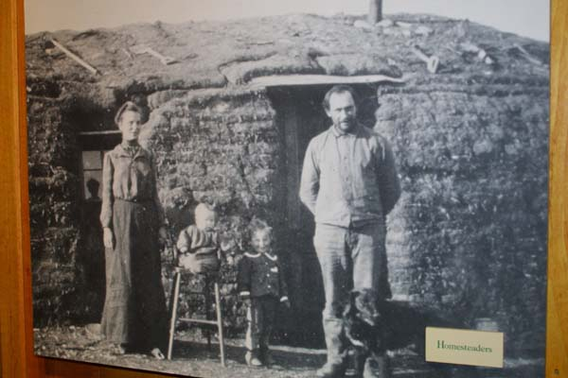
The next group came west as farmers – good productive land.
Then came groups of people like merchants and manufacturers – trying to make money by selling farmers products.

Slide 11
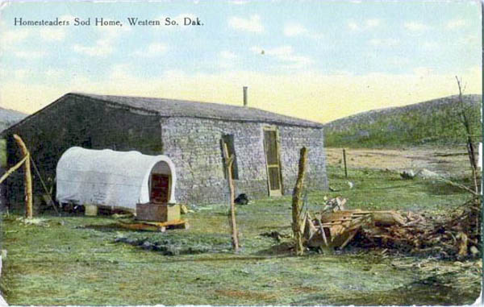
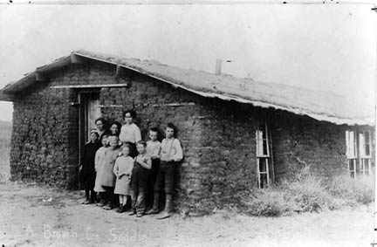
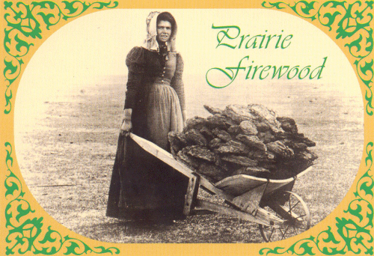

Slide 12
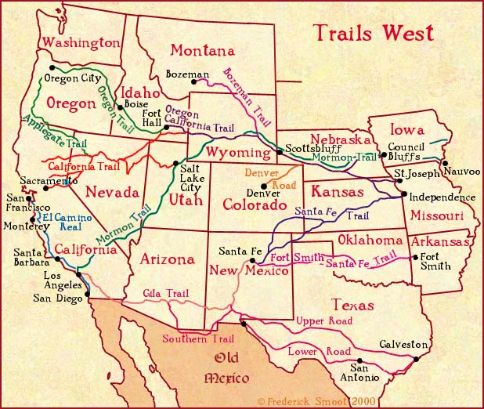
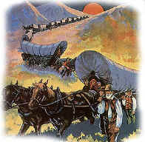
How would you get west?
On one of the several main trails west
The Oregon Trail
The California Trail
The Santa Fe Trail
The Old Spanish Trail
The Mormon Trail
The one you took depended on the purpose of your trip

Slide 13
The Trail to Santa Fe
Mexico gains independence (1821), opens borders to American traders
William Becknell goes to what is now Santa Fe, New Mexico and opens the Santa Fe Trail
Makes profit trading and news spreads that traders can get rich in New Mexico
Becknell makes another trip to Santa Fe, uses a shortcut
Soon hundreds of traders use same route from Missouri to New Mexico

Slide 14
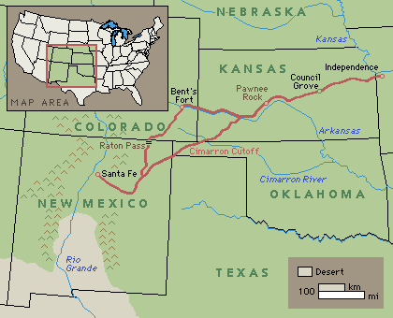
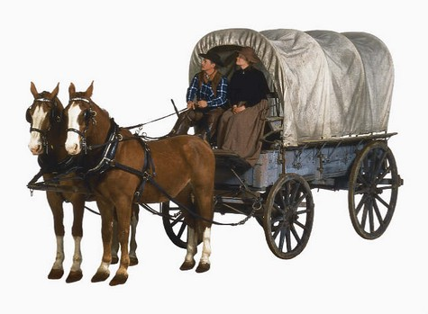
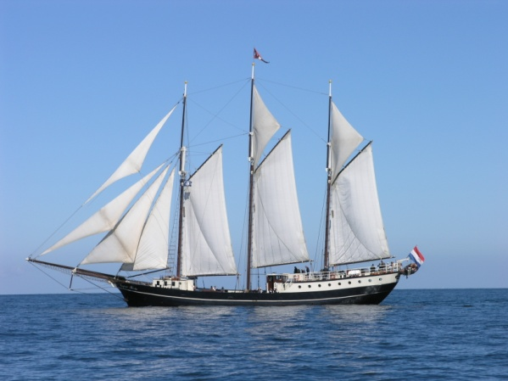
For example: The Santa Fe Trail
It was created and used for American businessmen who hoped to make a profit selling new products in Mexico – and some of them became VERY rich.
When people heard how much money you could make, lots more went – that’s the first time you hear of the “prairie schooner.”
From Missouri to Mexico was about 800 miles and the trip might take 2-3 months.

Slide 15
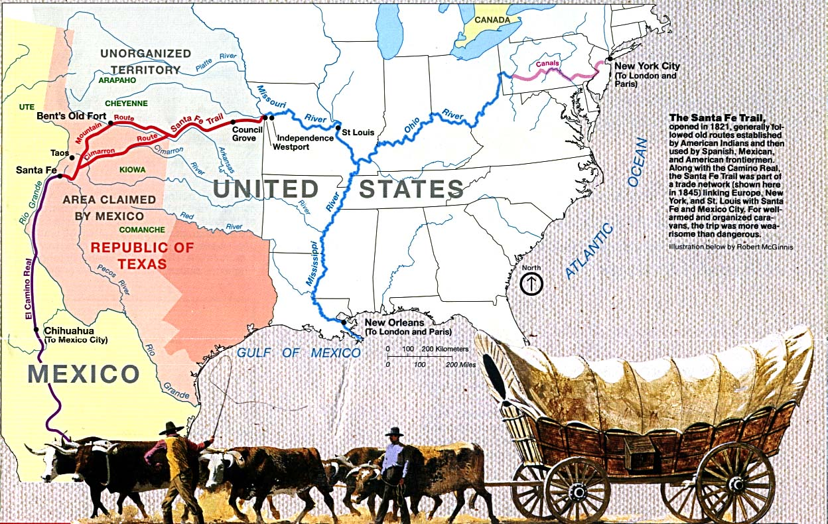

Slide 16
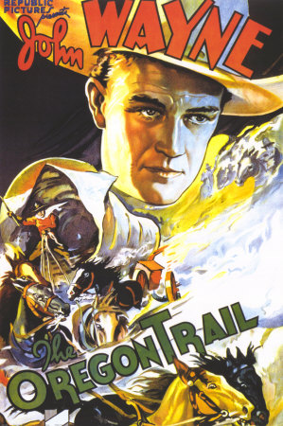
One trail most people have heard about: The Oregon Trail
The first white settlers to Oregon were missionaries.
Stories were spread about the rich land and thousands decided that Oregon was the place to go.

Slide 17
Oregon Fever
Hundreds of settlers begin migrating west on the Oregon Trail
First white settlers to cross to Oregon are missionaries
U.S., Britain argue over ownership of Oregon
Missionaries report about Oregon’s rich land, attract many settlers
In 1843, nearly 1,000 people travel from Missouri to Oregon

Slide 18
Oregon Trail
The route hundreds of farmers and missionaries travel to the Far West.

Slide 19
One Family Heads West
In 1844, Henry Sager, wife, 6 children leave Missouri for Oregon
Join wagon train, survival depends on cooperation
Wagon train sets up rules, elects leaders to enforce them
Life on the trail had many hardships

Slide 20
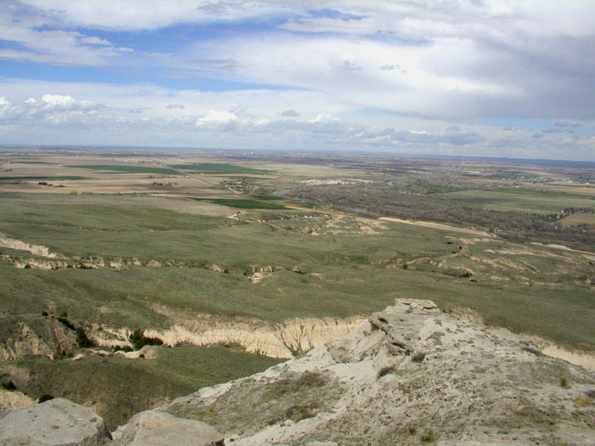
Today if you decide you want to go to Oregon, you might fly, or at least get in a car and take a couple of days to drive there.
But in 1840 it wasn’t that easy.
Wild Animals?
Sickness/disease?
Accidents?
Starvation/no water?
Freeze to death in the mountains?

Slide 21
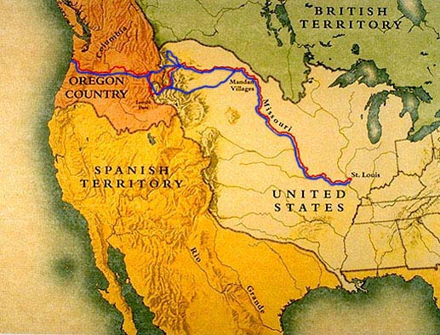
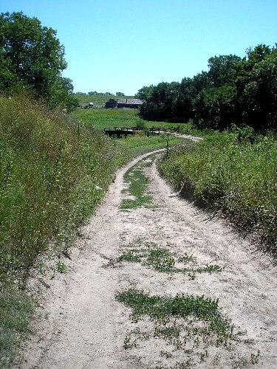
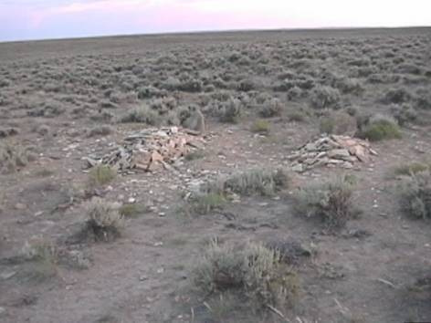
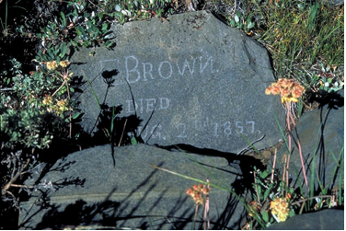

Slide 22
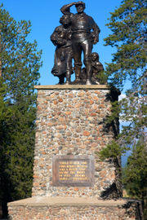
A group of travels heading out West that was written about was ”the Donner party”
They became trapped in the Sierra Nevada Mountains and were forced to build a winter camp with little food to sustain them. It was several weeks before rescue parties could be sent to help because of the Mexican War. Even after the war ended, not everyone could be rescued at once because of the harsh weather conditions and difficult terrain. The last of the survivors reached Sutter's Fort (now Sacramento, California) almost exactly one year later. Of the 87 members of the Donner Party, 46 survived the long, harsh journey out west.

Slide 23
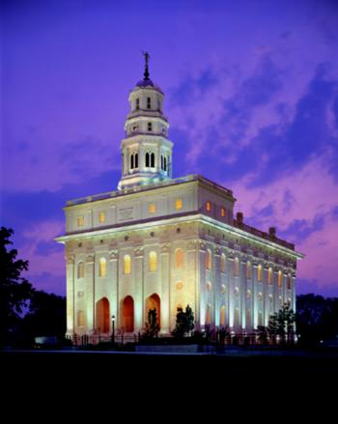
The Mormon Trail
Mormons are from the “Church of Jesus Christ of Latter Day Saints”
The Mormons were chased out of New England and moved to Illinois (Nauvoo).

Slide 24
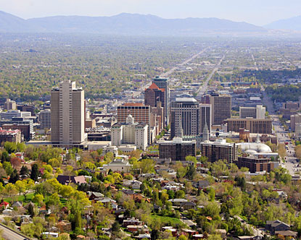
In Illinois, an anti Mormon mob killed Joseph Smith and they decided they needed a place to live where they would be able to practice their faith freely
The place they choose was out west – to the Utah Territory (their new leader was Brigham Young).
Utah at that time was actually part of Mexico.
When they got there, they settled by the Great Salt Lake – and many Mormon’s they’re still reside there today.
Today, Utah is about 60-75% Mormon

Slide 25
Mormons
This group of Americans sought religious freedom in the West

Slide 26
Chapter 11 Section2
The Texas Revolution

Slide 28
Tejas
Apache and Comanche lived there for many years and not many settlers out east were eager to fight them for their land.
Spain tried to give large tracts of land to lure settlers but there were few takers.
There were approximately 4,000 Tejanos living there at the time.
Meanwhile, Moses Austin later would attempt to start an American colony there.

Slide 29
Moses Austin Passes Away in 1821
Before he passed away, Moses got Spain to agree on a colony of Americans, but he had to agree that settlers on his land had to follow Spanish rules.
However, after years of fighting, Mexico gains its independence from Spain and Moses’ land grant was essentially and legally worthless.

Slide 30
What Happened After?
His son, Stephen Austin, wants to be a lawyer, but tries to fulfill his father’s dream of an American colony in Tejas.
Stephen Austin travels to Mexico City and gets Mexico to let him start a colony, but the settlers have to agree to become Mexican Citizens and Catholic.

Slide 31
American Begin to Settle in Tejas
Between 1821 and 1827, Stephen Austin convinces 297 families to move there.
By 1830, the population had grown to 30,000
The Americans outnumbered the Tejanos six to one by 1830.

Slide 32
Who were the Tejanos
1. People of Spanish heritage who lived in Texas
2. Some fought for independence from Mexico
3. Most had been in Texas longer than most Americans had been.

Slide 33
Rising Tensions in Texas
More and more Americans settles in Texas.
They resented following Mexican laws.
On the other hand, Tejanos thought the Americans believed they were superior and deserved special privileges.
Americans seemed unwilling to adapt to Mexican laws.

Slide 34
Mexico Sends an Official to Texas to Investigate the Tensions
He reports trouble brewing between the two side.
Then the Mexican government decide to crack down on those not following the Mexican laws in Texas.
First, it closed the state to further American immigration.
Next, it required Texans to pay taxes for the first time.
Finally, to enforce these new laws, the Mexican government sent more troops to Texas.

Slide 35
Texans Revolt Against Mexico
Some Texans began to talk about breaking away from Mexico.
Most people listened to Austin, who at this time was loyal to Mexico.
In 1833, Austin went to Mexico City with a petition requesting that Texas become a self-governing state within Mexico.
He met with General Santa Anna, the Mexican president.
At first, Santa Anna agreed to the reforms, but then he learned that Austin had said that if the changes weren’t approved, Austin would support breaking away from Mexico.
This would eventually lead to war.

Slide 36
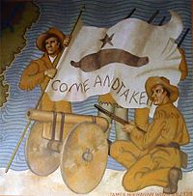
The Texans response, “COME AND TAKE IT”
The general Santa Anna sent Austin to jail for an entire year.
The Texans were furious and ready to rebel.
Santa Anna then sent even more troops to Texas.
The Mexican soldiers marched into the town of Gonzales.
They had orders to seize a cannon used by the Texans for protection against Native Americans.
Texas volunteers hung a flag on the big cannon that said:

Slide 37
What Happened Next?
The Mexican troops failed secure and get the cannon.
Two months later, Texans drove Mexican troops out of the Alamo.
Upset, Santa Anna sends 6,000 troops to Texas.
Texans now declare Texas a free and independent republic.
Sam Houston was placed in command of the Texas Army.
The Texas Army hardly existed up to this juncture.
There were only two small forces ready to stand up to Santa Anna’s larger army.

Slide 38
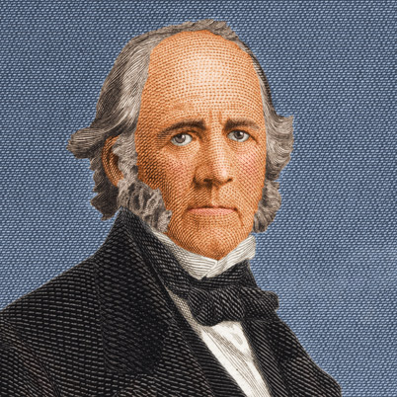
Sam Houston
Commanded the Texas Army and was president of the Texas Republic

Slide 39
Against All Odds
The Texans had 420 men stationed at Goliad.
The Texans also only had 183 volunteers at the Alamo.

Slide 40
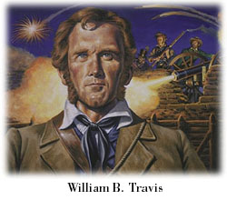
William Travis
Commanded the Texas forces at the Alamo in 1836

Slide 41
The Alamo Deconstructed The History Channel 2:48
Why You Should Remember the Alamo
The Smithsonian Channel 2:17

Slide 42
Remember the Alamo!

Slide 43
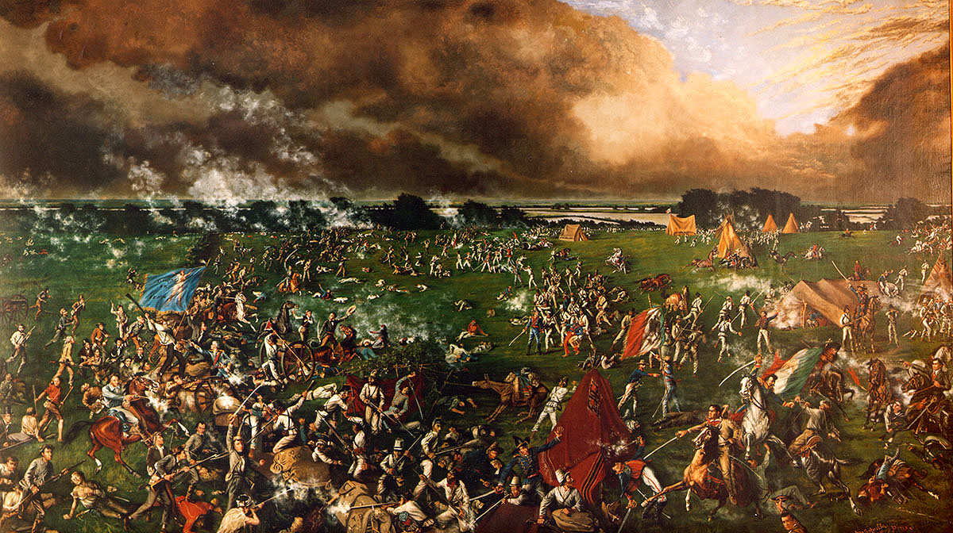
Victory at San Jacinto
The men at Goliad were captured and more than 300 of them were executed.
That made infuriated the Texans. Houston’s army doubled with an influx of new volunteers.
Santa Anna and Houston fought one another at the battle of San Jacinto.
In just 18 minutes, the Texans defeated more than half of the Mexican army.
Santa Anna was forced to sign a treaty giving Texas it’s freedom.
At this time, Texas became independent of Mexican rule.

Slide 44
Lone Star Republic
This is the nickname Texans adopted for Texas after they declared Texas to be an independent nation

Slide 46
Lone Star Republic
Many Texans didn’t want Texas to remain independent for long. They considered themselves Americans. And wanted to be annexed to the Union.
Many Northerners objected. They were against Texas becoming a slave state.
Congress then decided at the time to vote against annexation and Texas remained an independent republic for almost ten years.

Slide 47
Chapter 11 Section 3
The Mexican-American War

Slide 48
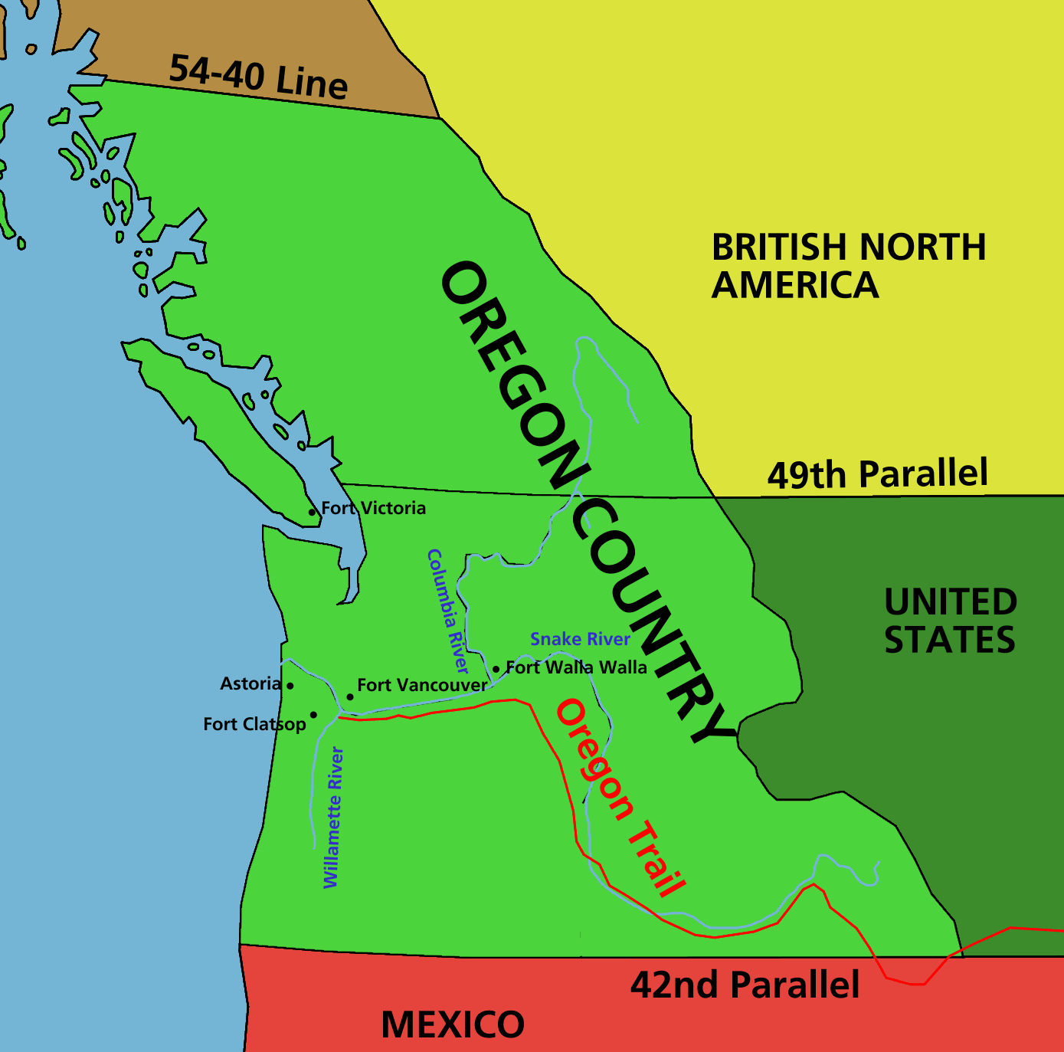
Since 1818, Oregon had been occupied jointly by the U.S. and Britain
Polk’s presidential campaign emphasized expansion of the United States.
He talked of taking over all of Oregon

Slide 49
Polk Campaign Slogan “FIFTY-FOUR FORTY OR FIGHT!”
This was one of Polk’s campaign slogans
The parallel of 54° 40’ N latitude was the northern boundary of the shared Oregon Territory.
Rather than fight for all of Oregon, however, Polk settled for half.
In 1846, the two sides agreed to divide Oregon at the 49th parallel.
It extended the boundary line already drawn between Canada and the U.S.

Slide 50
The Oregon Country
The United States settled for less land than it orignally wanted.

Slide 51
Troubles with Mexico
Polk had good reasons to avoid war with Britain
He had much bigger issues involving the ongoing conflict between Mexico and Texas

Slide 52
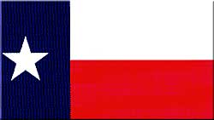
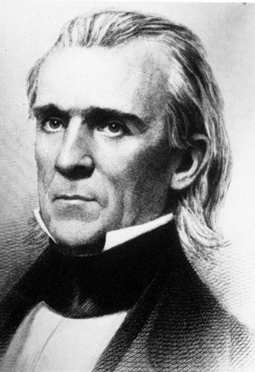
Annexation of Texas
Many Texans want to join the U.S. after it became independent.
Mexico warned the U.S. to not annex, or take control of, Texas
President Polk offered to buy California
Mexicans were convinced the U.S. intended to take the entire continent of North America.
They refused to sell California.
President Polk

Slide 53
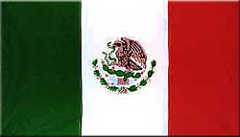
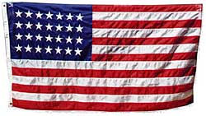
The War Begins
April 25, 1846 Mexican and American forces clashed in disputed territory
Texas boundary dispute
11 American soldiers killed
U.S. declared war two days later
American armies moved into California, New Mexico, and Texas to defend territories
California and New Mexico surrendered

Slide 54
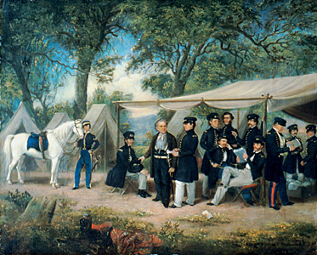
Mexican American War: Invading Mexico
Zachary Taylor at his encampment during the Mexican War
Zachary Taylor led 6,000 U.S. troops into Mexico
Santa Anna led an army of 20,000
Both met near Monterey in 1847
Santa Anna retreated

Slide 55
The War
The Invasion of Mexico
The defeat of Mexico was difficult, because the Mexican army was much larger in size, but the U.S. troops were led by well-trained officers. American forces invaded Mexico from two directions.
This proved successful in winning the War with Mexico.

Slide 56
The U.S. military strategy that proved to most successful in winning the War with Mexico was the American forces invading Mexico from more that one direction.

Slide 57
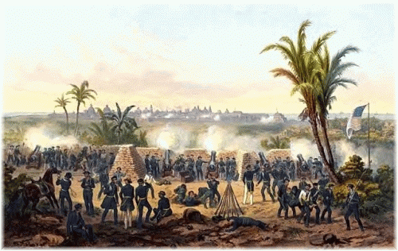
Battles
Winfield Scott led the American navy to Vera Cruz and captured it on March 27 with 10,000 troops.
The Mexican army made a last stand at Chapultapec Castle, Sept. 13, 1847
Los Niño's Heroes
Mexico surrendered February 2, 1848
Battle of Vera Cruz fought in March of 1847

Slide 58
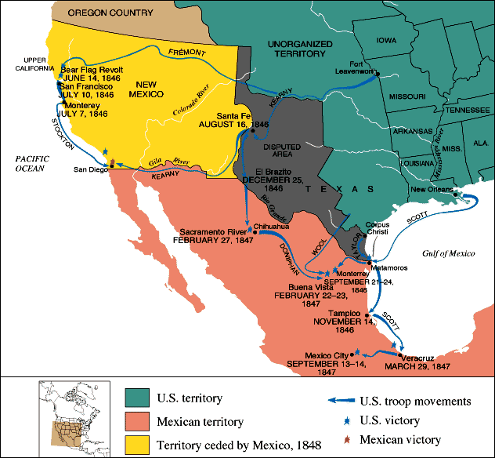
The Mexican-American War, 1846-1848

Slide 59
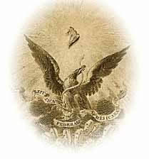
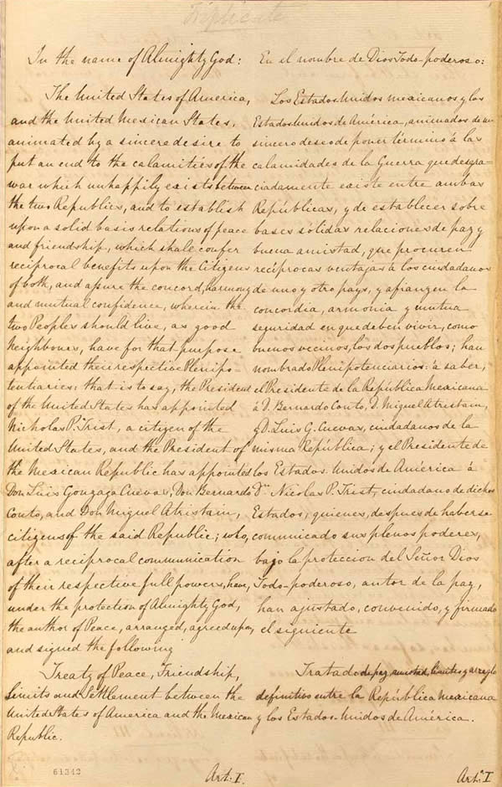
Treaty of Guadalupe Hidalgo
Agreement that marked the end of the War with Mexico
Mexico was paid $15 Million
Another $3 million in debt was forgiven
Increased Size of the U.S. by almost 25%

Slide 60
Mexican Cession-land the U.S. acquired from Mexico included present-day California, Nevada, and Utah, & parts of Arizona, New Mexico, & Wyoming

Slide 61
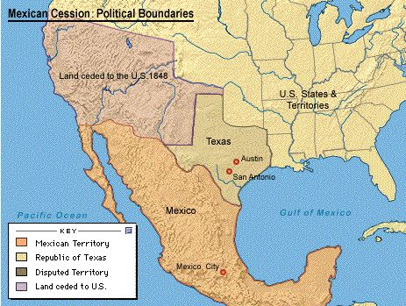
Mexican Cession

Slide 62
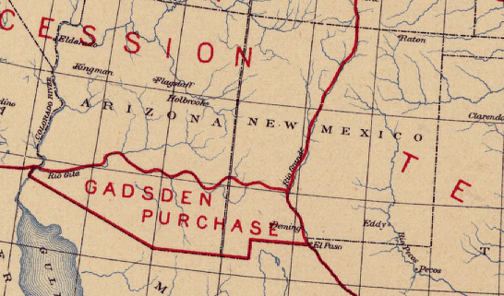
Gadsden Purchase of 1853
U.S. paid Mexico $10 million for southern parts of present-day Arizona and New Mexico.
This land was needed
for the expansion of
the Railroads.

Slide 63
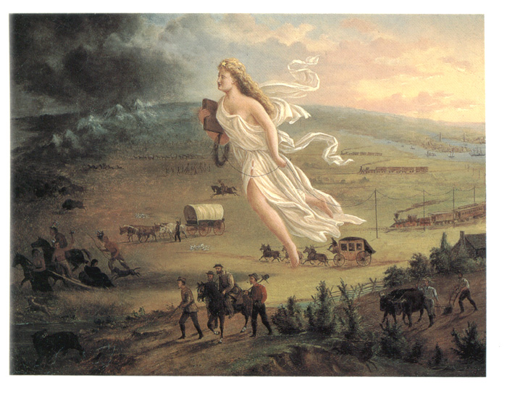
The idea of the Manifest Destiny was Fulfilled The belief that the United States, having the best government and culture in the world, had the right and duty to control all lands from the Atlantic to the Pacific.

Slide 64
Chapter 11 Section 4
The California Gold Rush

Slide 65
California Before the Gold Rush
Before the “forty-niners” came, California was populated by as many as 150,000 Native Americans and 8,000 to 12,000 Californios-settlers of Spanish or Mexican descent.

Slide 66
What did the James Marshall’s discovery lead to?
The California gold rush

Slide 67
Three Results of the Gold Rush
1.Many white American, European, and African-American miners joined the Californios as permanent residents of California.
2. Thousands of Mexican miners came to California.
3.Many Chinese miners left the gold mining fields and started businesses.

