Slide 1
Chapter 11 – Expanding West
Section Notes
Video
Trails to the West
The Texas Revolution
The Mexican-American War
The California Gold Rush
The Impact of the California Gold Rush
Maps
Trails Leading West
The Texas Revolution
Mexican-American War, 1846-1847
Skills Page Map: Expansion
Growth of the United States to 1853
Standardized Test Practice Map
History Close-up
Ranch Life
Quick Facts
Westward Movement in the United States
Chapter 11 Visual Summary
Images
Mormon Pioneers
Manifest Destiny
Battle of Buena Vista
Staking a Claim

Slide 2
Trails to the West
The Big Idea
The American West attracted a variety of settlers.
Main Ideas
During the early 1800s, many Americans moved west of the Rocky Mountains to settle and trade.
The Mormons traveled west in search of religious freedom.

Slide 3
Main Idea 1: During the early 1800s, many Americans moved west of the Rocky Mountains to settle and trade.
Some of the first Americans in the West were mountain men: fur traders and trappers.
Many settlers traveled west over the Oregon Trail.
The Santa Fe Trail was another important path west.

Slide 4
Mountain Men
Fur traders and trappers were some of the first Americans to explore the West.
John Jacob Astor created one of the largest fur businesses, the American Fur Company.
Astor founded Astoria, one of the first settlements in Oregon Country.

Slide 5
Oregon Trail
Settlers were lured by rich resources and the mild climate.
The trail was 2,000 miles, beginning in Iowa or Missouri and ending in Oregon or California.
It was a hard journey because of food shortages, bad weather, and mountains and rivers that were difficult to cross.

Slide 6
Santa Fe Trail
The route led from Independence, Missouri, to Santa Fe, New Mexico.
Was originally a Native American trading route
Traders used the route to trade American goods for Mexican goods; traders made high profits.
Difficult journey due to hot desert and rough mountains

Slide 7
Main Idea 2: The Mormons traveled west in search of religious freedom.
Joseph Smith founded the Church of Jesus Christ of Latter-day Saints in western New York in 1830.
Their book of religious teachings is called the Book of Mormon.
Church members were persecuted because of beliefs, including polygamy (one man married to several women).
Joseph Smith was murdered by a mob in 1844.
Brigham Young became the new head of the church and moved the group to Utah.
Thousands of Mormons took the Mormon Trail to Utah.
By 1860, there were about 40,000 Mormons in Utah.

Slide 8
The Texas Revolution
The Big Idea
In 1836, Texas gained its independence from Mexico.
Main Ideas
Many American settlers moved to Texas after Mexico achieved independence from Spain.
Texans revolted against Mexican rule and established an independent nation.

Slide 9
Main Idea 1: Many American settlers moved to Texas after Mexico achieved independence from Spain.
Father Miguel Hidalgo y Costilla, a Mexican priest, led an unsuccessful revolt against Spain in 1810.
Mexico gained independence in 1821.
The new Mexican government hired empresarios, or agents, to bring settlers to Texas.
Stephen F. Austin, an agent, started a colony on the lower Colorado River in 1822.
Success attracted more American settlers, who received free land in exchange for obeying Mexican laws.
Mexico was concerned about the number of Americans and banned further settlement.
General Antonio López de Santa Anna became the ruler of Mexico.

Slide 10
Main Idea 2: Texans revolted against Mexican rule and established an independent nation.
War began October 1835 in a battle at Gonzales, Texas.
Texans declared independence on March 2, 1836.
The Republic of Texas was established.
Sam Houston was named head of the Texas army.
Stephen F. Austin went to the United States to seek money and troops.

Slide 11
Major Battles
Battle at the Alamo
Texans’ actions angered Santa Anna.
Texas force of fewer than 200, led by Colonel Jim Travis, occupied Alamo mission near San Antonio.
From February 23 to March 6, 1846, Texans held out against huge Mexican army.
All defenders killed in Mexican attack on March 6.
Battle of San Jacinto
Santa Anna chased Texans under Sam Houston east.
Texans took stand at San Jacinto River near Galveston Bay.
Houston’s forces attacked on April 21, 1836, and destroyed Mexican army.
Santa Anna captured at Battle of San Jacinto and forced to sign treaty giving Texas independence.

Slide 12
An Independent Nation
Sam Houston was the hero of the new independent nation of Texas. Houston was elected president; Stephen F. Austin became secretary of state.
To increase the population, Texas offered land grants to new settlers. Many from nearby southern states brought enslaved Africans with them.
Most Texans hoped that the United States would annex, or take control of, Texas and make it a state.
President Jackson recognized Texas as an independent nation, but did not want to upset balance between slave and free states by letting a slave state enter the Union.

Slide 13
The Mexican-American War
The Big Idea
The ideals of manifest destiny and the outcome of the Mexican-American War led to U.S. expansion to the Pacific Ocean.
Main Ideas
Many Americans believed that the nation had a manifest destiny to claim new lands in the West.
As a result of the Mexican-American War, the United States added territory in the Southwest.
American settlement in the Mexican Cession produced conflict and a blending of cultures.

Slide 14
Main Idea 1: Many Americans believed that the nation had a manifest destiny to claim new lands in the West.
Americans believed they could build a new, better society founded on democratic principles.
The United States had a booming economy and population in the 1840s.
Needed more space for farms, ranches, businesses, and families
Looked to the West
Some believed it was America’s manifest destiny, or obvious fate, to settle all land to the Pacific.
Question was whether slavery would be allowed in new territories.

Slide 16
Acquiring New Territory
Democrat James K. Polk elected in 1844; favored acquiring Texas and Oregon; was perceived as the expansionist candidate.
Oregon
Polk avoided war with Britain over Oregon and negotiated treaty for land south of forty-ninth parallel.
Oregon organized as territory in 1848.
Texas
Texas annexed in 1845, but this action angered Mexico.

Slide 17
California under Mexico
Mexico had lost Texas but controlled other areas in the present-day Southwest—New Mexico, Arizona, Nevada, and California.
The mission system was important in California, carrying out huge farming and ranching operations using Native American labor.
Missions were broken up in the 1830s by Mexico.
Land grants given to wealthiest California settlers
Created vast ranchos, or ranches
Worked by vaqueros, or cowboys
About 3,200 settlers, or Californios, were in California in the early 1820s.
Anglos, settlers from the United States, started to arrive in small numbers. They began calling for independence.

Slide 18
Mexican-American War
Conflict Breaks Out
The United States and Mexico were engaged in border disputes.
John Slidell went to Mexico to try to buy New Mexico and California for $30 million. Mexican officials refused to speak to him.
Polk ordered General Zachary Taylor and his army into the border region around the Rio Grande in 1846.
U.S. troops clashed with Mexicans in April.
War Begins
Congress declared war on Mexico in April.
Taylor’s forces won battles south of the Rio Grande in Mexico.
General Stephen Kearny seized control of New Mexico.

Slide 19
Bear Flag Revolt
Only about 500 Americans were in California in 1846, in contrast to about 12,000 Californios.
Settlers
Americans seized Sonoma and declared California to be an independent nation on June 14, starting the Bear Flag Revolt.
Revolt
John C. Frémont
Frémont, leader of a U.S. Army mapping expedition, entered California to support its independence.
U.S. naval and military forces invaded California in July 1846 and claimed California for the United States.
U.S. Forces

Slide 20
War’s End
Buena Vista
General Taylor’s forces defeated the Mexican army under Santa Anna at Buena Vista in February 1847.
The Mexican army had fled overnight.
It was a fierce battle with heavy casualties on both sides.
Veracruz
General Winfield Scott’s forces seized the port of Veracruz in March 1847.
Veracruz was the strongest fortress in Mexico.
Mexico City
Scott’s troops took Mexico City in September 1847 after a brave defense by Mexican soldiers.

Slide 21
Main Idea 2: As a result of the Mexican-American War, the United States added territory in the Southwest.
Treaty of Guadalupe Hidalgo officially ended the war in 1848.
Mexican Cession included present-day California, Nevada, and Utah, and parts of Arizona, New Mexico, Colorado, and Wyoming.
Mexicans in the cession areas were “protected in the free enjoyment of their liberty and property, and secured in the free exercise of their religion.”
Also included area claimed by Texas north of Rio Grande
Increased size of United States by almost 25 percent
In the Gadsden Purchase of 1853, the United States paid $10 million for southern parts of present-day Arizona and New Mexico.

Slide 22
Main Idea 3: American settlement in the Mexican Cession produced conflict and a blending of cultures.
Surge of American Settlers
Americans flooded into the Southwest.
New settlers battled longtime residents to control land, water, and minerals.
Most Mexicans, Mexican Americans, and Native Americans faced legal, economic, and social discrimination from settlers.
Cultural Encounters
Different cultures shaped one another in the Southwest despite conflicts.
Names of places showed Hispanic and Native American heritage.
Mexican and Native American knowledge and traditions also shaped many local economies.

Slide 23
The California Gold Rush
The Big Idea
The California gold rush changed the future of the West.
Main Ideas
The discovery of gold brought settlers to California.
The gold rush had a lasting impact on California’s population and economy.

Slide 24
Main Idea 1: The discovery of gold brought settlers to California.
California controlled by Mexico before Mexican-American War.
Population was mostly Mexicans and Native Americans.
Mexican officials gave Swiss immigrant John Sutter permission to found a colony there in 1839.
Became a popular rest stop for immigrants.
Donner Party: group of early settlers traveling to California in 1846 that became lost in the Sierra Nevada during heavy snows and lost 42 of 87 members to starvation.

Slide 25
Gold in California
Gold was discovered at Sutter’s Mill in January 1848.
About 80,000 gold-seekers came to California in 1849; they were called forty-niners.
They would prospect, or search for gold, along banks of streams or in surface mines.
Placer miners used pans to wash gold nuggets out of loose rock and gravel.
California produced $60 million in gold in 1853.

Slide 26
Life in the Mining Camps
Mining camps sprang up wherever enough people gathered to look for gold.
Miners came from many cultures and backgrounds.
Most were young, unmarried men in search of adventure.
80% were Americans; the rest came from around the world.
Only 5 percent of gold-rush immigrants were women or children.
Women generally made good money by cooking meals, washing clothes, and operating boardinghouses.
Miners paid high prices for basic necessities because the huge amount of gold in circulation caused severe inflation in California.

Slide 27
Westward Movement in the United States
Causes
Americans believe in idea of manifest destiny
United States acquires vast new lands in West
Pathfinders open trails to new territories
Gold is discovered in California
Effects
Native Americans are forced off lands
Americans travel west to settle new areas
United States stretches to Pacific
California experiences population boom

Slide 28
Immigrants to California
The lure of gold attracted miners from around the world.
Many Chinese men came in hopes of making great wealth and then returning to China—about 24,000 from 1849 to 1853.
Many Americans did not welcome the Chinese, but the Chinese still worked in gold mines, opened their own businesses, and held other jobs.
In 1853 California placed a high monthly tax on foreign miners.
The legal system favored Americans over immigrants.
In 1849 alone, about 20,000 immigrants arrived in California from China, Europe, Mexico, and South America.

Slide 29
Main Idea 2: The gold rush had a lasting impact on California’s population and economy.
Population Boom
Population explosion quickly made California eligible for statehood.
Became 31st state in 1850.
Growth had negative effect on Californios and Native Americans in California.
Economic Growth
New businesses and industries transformed California.
Completion of transcontinental railroad in 1869 ended isolation from rest of country and aided economy.

Slide 30
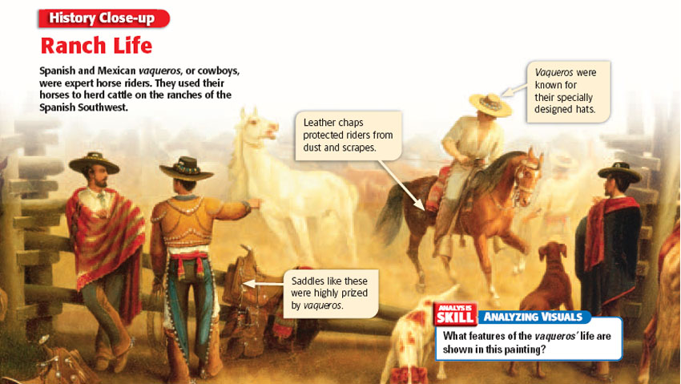

Slide 31
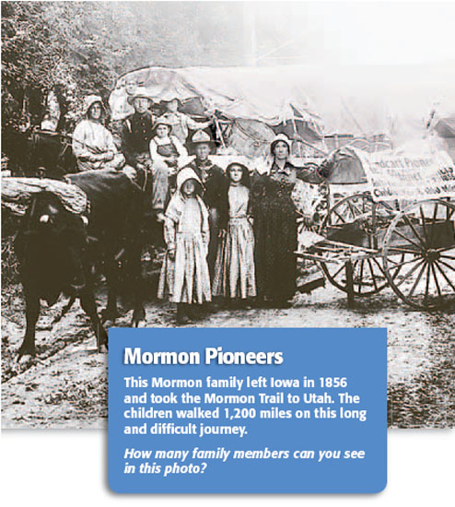

Slide 32
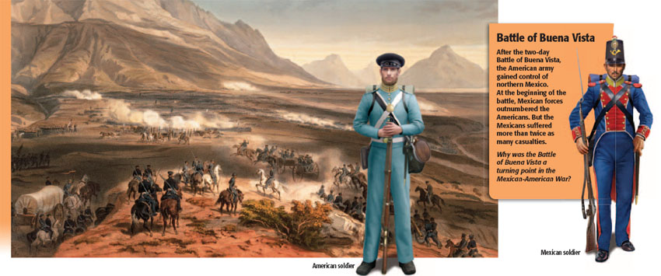

Slide 35
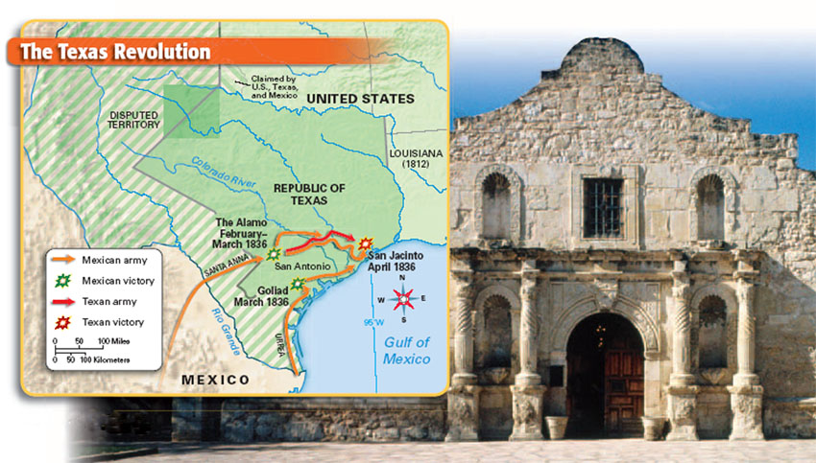

Slide 36
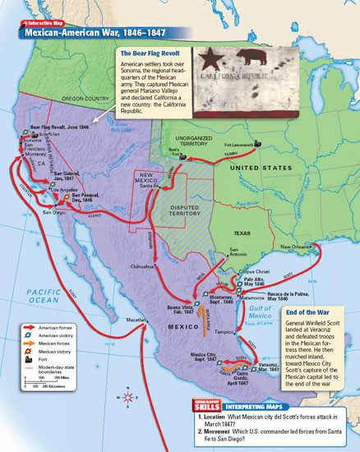

Slide 37
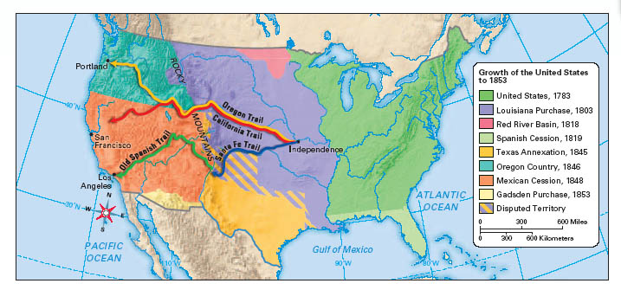

Slide 38
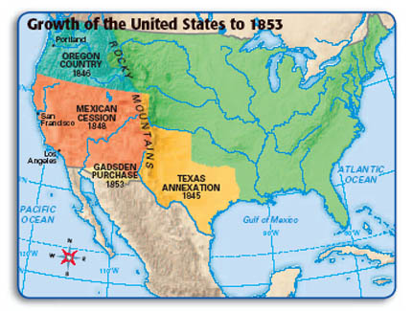

Slide 39
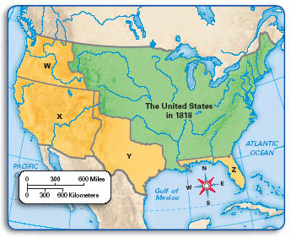

Slide 41
