Slide 1
Chapter 11
Expanding West

Slide 2
American Stories
Probing the Trans-Mississippi West
Winning the Trans-Mississippi West
Going West and East
Living in the West
Cultures in Conflict
Conclusion: Fruits of Manifest Destiny

Slide 3
Probing the Trans-Mississippi West

Slide 4
The International Context
Spanish control of most of the West
Little direct control
Liberal challenge in Spain, 1820
Mexico declares independence, 1821
Northwest
Claimed by Russia, Spain, Great Britain
By 1824, just the U.S. and Britain

Slide 5
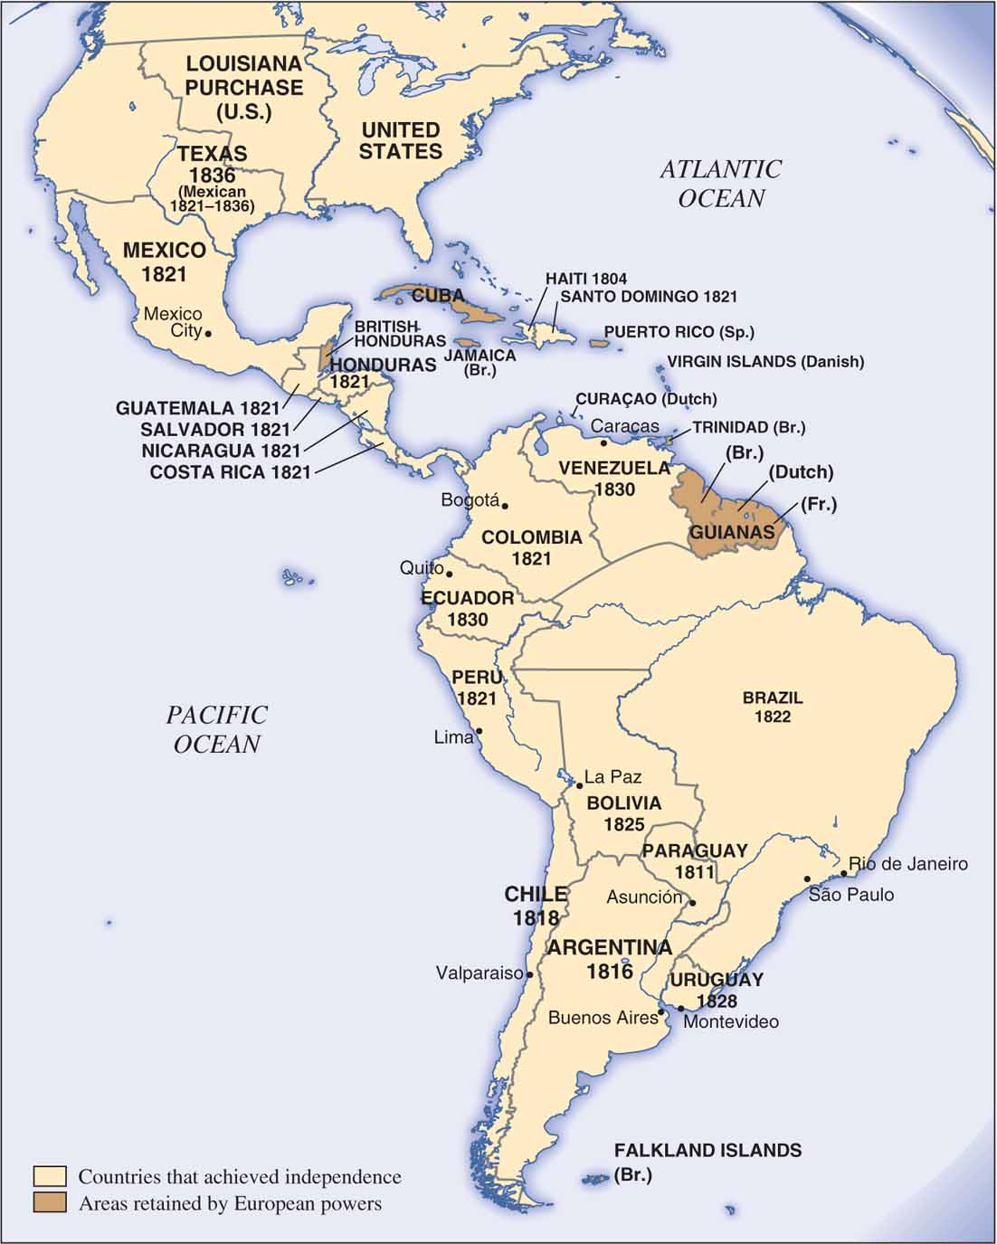
North and South America, 1800–1836
North and South America, 1800–1836 Events in Europe had a dramatic impact on the Americas. Napoleon’s defeat of the Spanish king in 1808 and the popularization of the ideas of the French Revolution contributed to ending Spanish rule in the New World. Note how rapidly countries claimed their independence in the southern hemisphere and Latin America. How did the changing political landscape of the Americas affect the power and influence of the United States in the region?
Notes:
5

Slide 6
Early Interest in the West
Fur traders
Missionaries build outposts
From 1821, new opportunities
Santa Fe Trail
New England traders come by sea
These areas still outside American borders

Slide 7
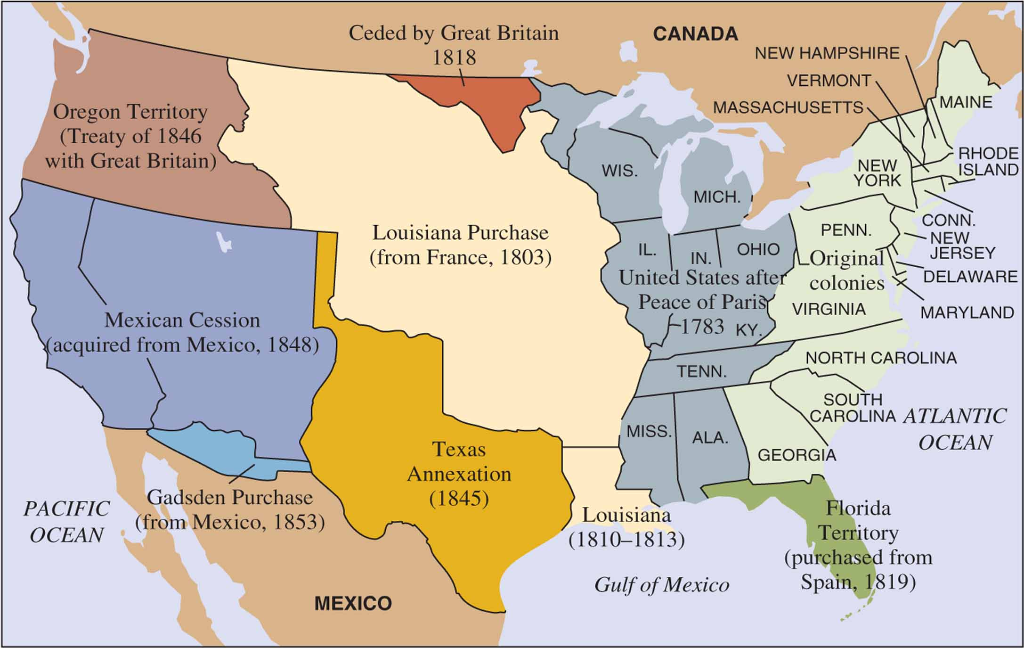
United States Territorial Expansion by 1860
United States Territorial Expansion by 1860 What does this map suggest about the time involved in acquiring the Far West?

Slide 8
Manifest Destiny
Coined in 1845
Implications
Geographic determinism
Holy justification for conquest

Slide 9
Winning the Trans-Mississippi West

Slide 10
Annexing Texas, 1845
Mexico encourages settlement, from 1823
By 1830, Tejanos only 1/3 of population
Mexican government halts immigration
Uprising
Antonio Lopéz de Santa Anna sent
Independence of Texas recognized, 1836

Slide 11
Annexing Texas, 1845 (cont'd)
Election of 1844
Annexation of Texas central
Texas joins the Union, 1845

Slide 12
War with Mexico, 1846-1848
Polk acts aggressively
Mexico reacts
War begins in April, 1846
Lacks popular support
Negotiations end the war

Slide 13
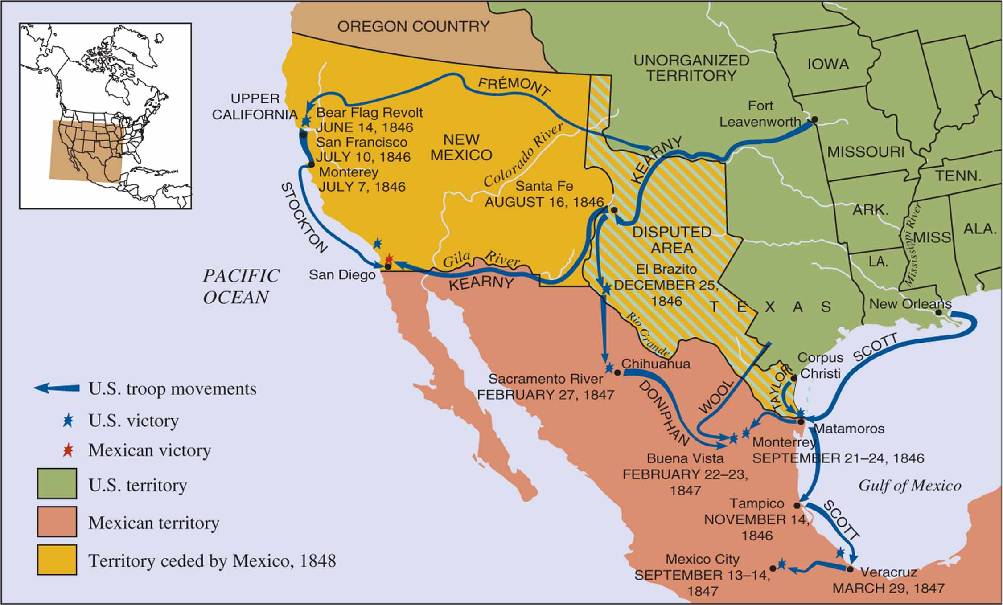
The Mexican-American War
The Mexican-American War What does this map reveal about the movements of American troops during the Mexican-American war? Would you consider American actions equivalent to an invasion? How large an area was in dispute between the Americans and the Mexicans?
Notes:
13

Slide 14
California and New Mexico
Polk wanted California and New Mexico as well
Sends Stephen W. Kearney with troops
Take Santa Fe
Takeover welcomed by elites
Others resist, but overcome

Slide 15
California and New Mexico (cont'd)
Treaty of Guadalupe Hidalgo, 1848
Rio Grande set as border with Mexico
California and New Mexico added

Slide 16
The Oregon Question, 1844-1846
Britain losing interest in Oregon
Polk’s call for 54°40’ makes a deal difficult
Few support his aggressive stance
Boundary set at 49th parallel

Slide 17
United States Territorial Expansion by 1860
United States Territorial Expansion by 1860 What does this map suggest about the time involved in acquiring the Far West?

Slide 18
Going West and East

Slide 19
Going West and East
Chinese emigration
Most to U.S. stay in California
American migration
Mostly middle class
Most from Midwest and Upper South

Slide 20
Going West and East (cont'd)
Motives
Gold
Farmland – squatters’ rights
Health
Missionary work

Slide 21
The Overland Trails
Begin in Iowa or Missouri
Troubles often began with mountain crossings

Slide 22
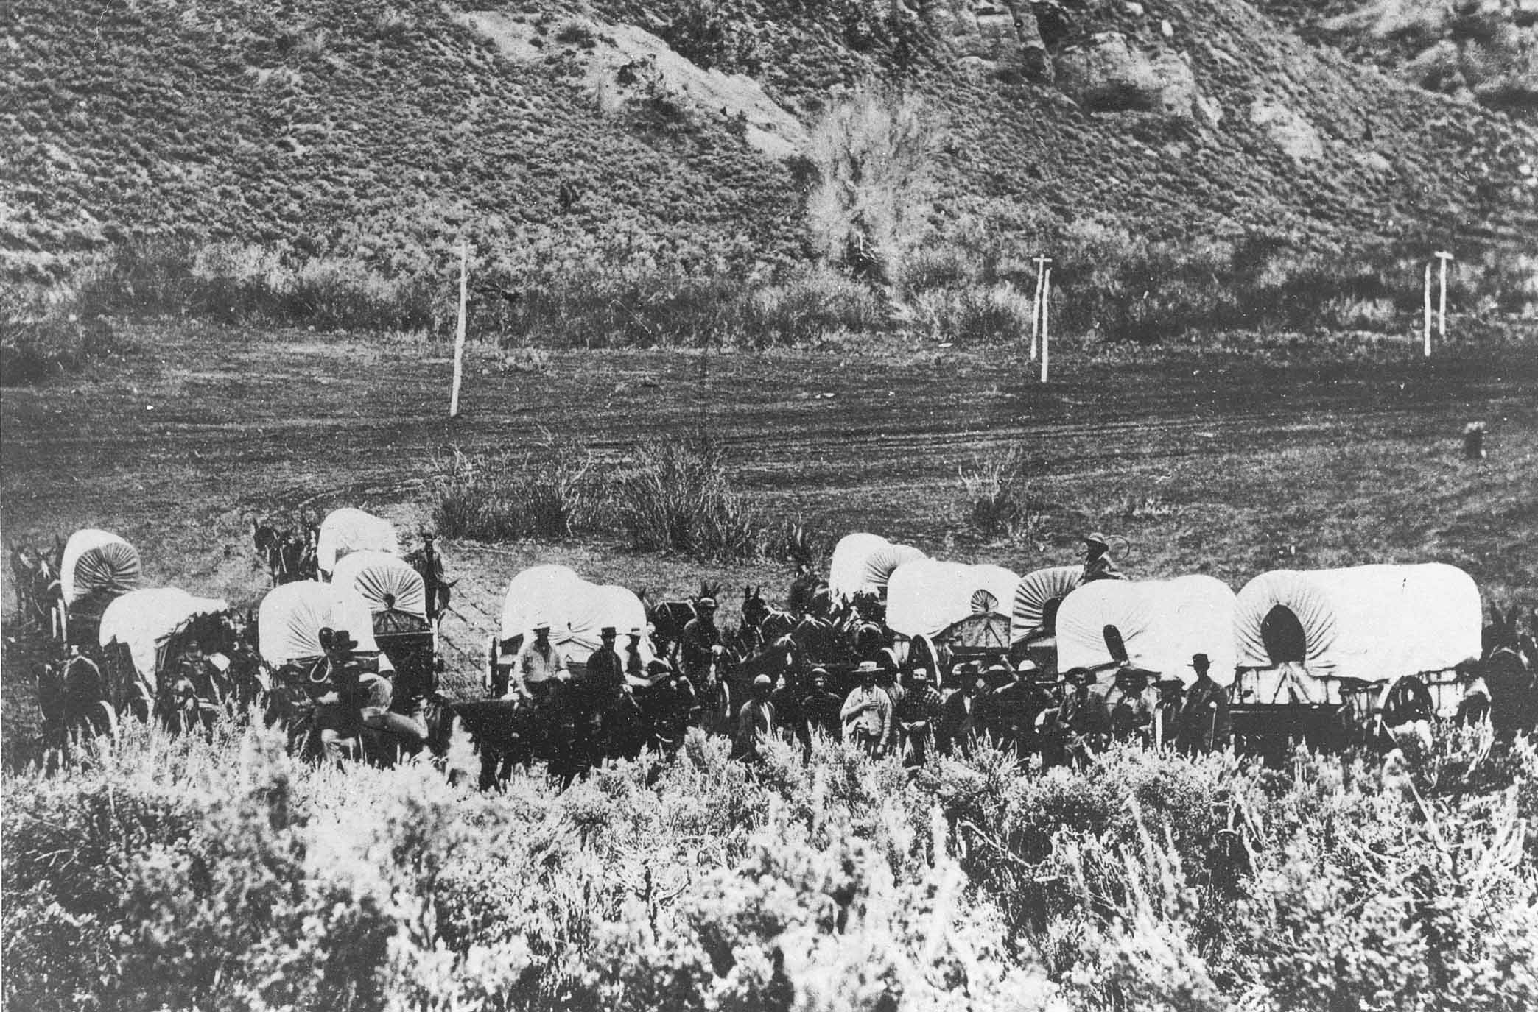
A Mormon Wagon Train
Notes:
A Mormon Wagon Train What does this view of a Mormon wagon train in the 1850s suggest about the terrain that emigrant families encountered as they went west? The Mormon migrations were the most organized of the migrations into the trans-Mississippi West, although not all Mormons were lucky enough to travel by wagon. Some emigrants to Utah pushed handcarts across the plains to their destination.

Slide 23
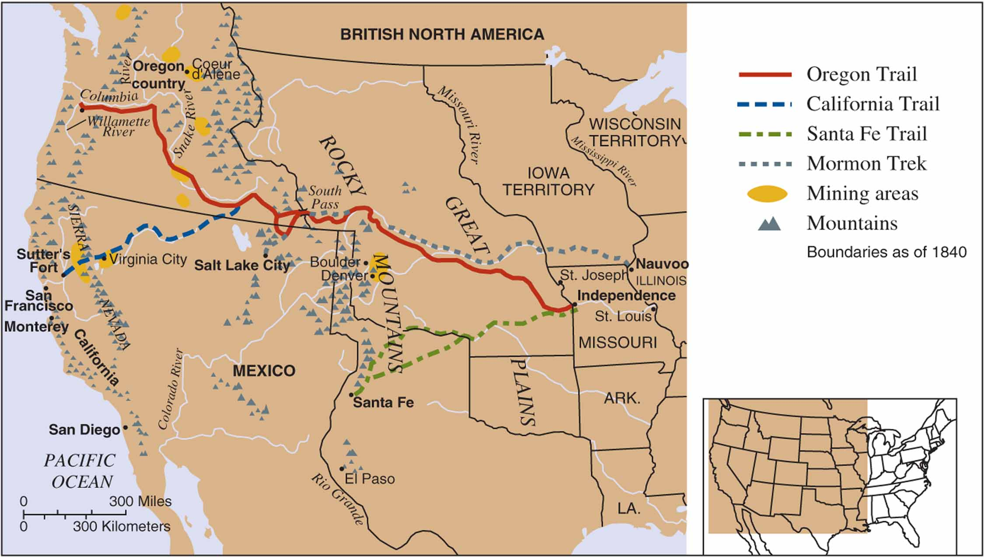
Overland Trails to the West
Overland Trails to the West The various trails over which thousands of Americans traveled during the 1840s, 1850s, and 1860s are depicted on this map. What natural obstacles do the map’s geographic features suggest the travelers faced, and at what point during their trip did travelers encounter them?
Notes:
23

Slide 24
Living in the West

Slide 25
Living in the West
First tasks of clearing difficult
Extreme isolation
Attempts to reestablish familiar institution
Schools
Political systems

Slide 26
Mining
Discovery of gold in California, 1848
Mostly unmarried young men head west
Further discoveries in 1850s,1860s
British Columbia, Rockies, South Dakota
Instant mining towns
Marked by conflict

Slide 27
Mining (cont'd)
Racial discrimination
Blacks, Chinese face hostility
Native Americans discriminated against

Slide 28
Establishing God’s Kingdom
Salt Lake City
Center of Deseret
Overlap between secular and religious spheres
Utah becomes part of the U.S.
Different lifestyle

Slide 29
Cities
San Francisco, Denver, Portland
Disproportionately young, male
This changes by late 1800s
Perception of greater opportunity

Slide 30
Cultures in Conflict

Slide 31
Cultures in Conflict
Most Chinese from southern China
Seen by certain Americans as competitors for jobs
California passes new laws

Slide 32
The Plains Tribes
Cultural differences
White Americans rarely valued Indian traditions
Plains Indians
Different from eastern Native Americans
Some more aggressive
Many mobile
Small-scale warfare common
Dependent on buffalo

Slide 33
The Plains Tribes (cont'd)
The Gold Rush worsens conditions

Slide 34
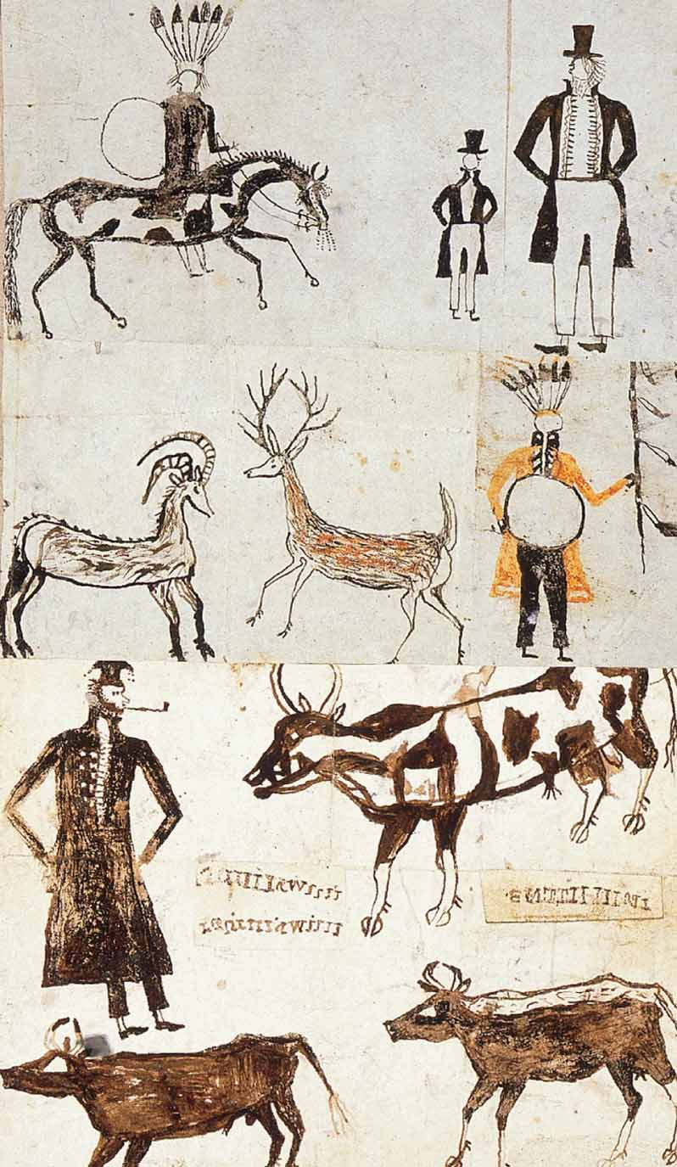
An Indian Contrast
A Native American Contrast This drawing, done by an unknown Indian artist sometime in the 1840s, contrasts the traditionally clad Indians and the wild animals they hunted with the formally dressed white men and their stock animals. Has the artist depicted whites in a sympathetic manner? (Archives de Jesuites, St. Jerome, Québec)
Notes:
34

Slide 35
The Fort Laramie Council, 1851
Council called by U.S. government
Fort Laramie Treaty
First treaty with plains Indians
Boundaries drawn – unrealistic

Slide 36
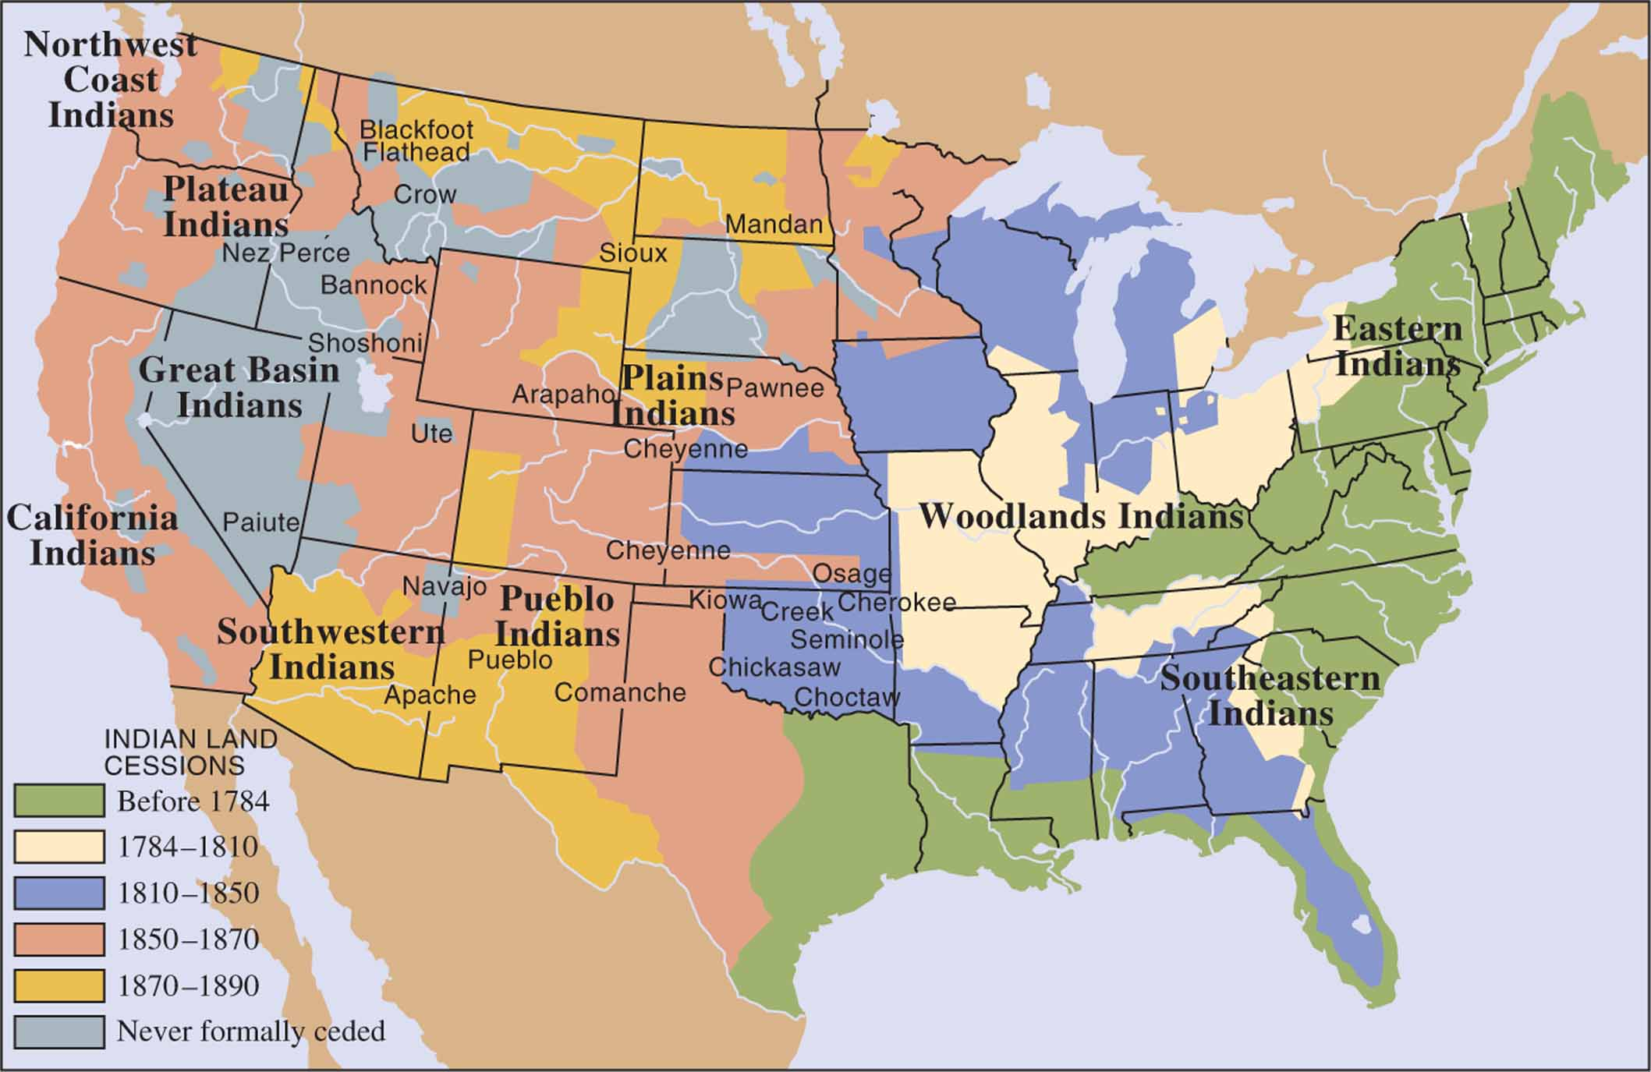
Indian land Cessions in 1840
Indian land Cessions in 1840 This map of Indian tribes and groupings reveals locations in 1840, but it presents too static a picture of tribal territories. Some of the Indian groups in the West had been forced across the Mississippi by events in the Midwest. What does the map show about the pace of Indian land cessions in the nineteenth century, especially in the trans-Mississippi West?
Notes:
36

Slide 37
Overwhelming Mexican Settlers
Spanish-speaking populations
Disregarded by Anglo settlers
Most continuity in New Mexico
Gwin Land Law, 1851
Violated Treaty of Guadalupe Hidalgo
Resistance
Some become bandidos
Sabotage

Slide 38
Conclusion: Manifest Destiny

Slide 39
Conclusion: Fruits of Manifest Destiny
Settlement of the West
Settlers bring of entitlement
Expansion becomes part of national culture
Few achieve their dreams of success

Slide 40
Timeline
Notes:
Timeline
40

