Slide 1
Objectives
Describe the geography and climate of the Middle Colonies.
Describe the early history of New York and New Jersey.
Explain how Pennsylvania and Delaware were founded.
Explain how the Middle Colonies changed in the 1600s and early 1700s.

Slide 2
Terms and People
proprietary colony – a colony created by a grant of land from a monarch to an individual or family
royal colony – a colony controlled directly by the English king
William Penn – a Quaker leader who established the Pennsylvania colony and its capital, Philadelphia
backcountry – a frontier region extending through several colonies, from Pennsylvania to Georgia

Slide 3
How did the diverse Middle Colonies develop and thrive?
Colonists settled in the Middle Colonies for freedom of religion or to profit from trade, farming, or other occupations.
Factors such as fertile soil, manufacturing, and social equality promoted the colonies’ prosperity.

Slide 4
Geography of the Middle Colonies
Location | New York, Pennsylvania, New Jersey, and Delaware (in order from largest to smallest) were the Middle Colonies.
Landforms | Much of the Middle Colonies is lowlands. The Hudson and Delaware rivers are important waterways in the region. The soil is fertile and well-suited for crops like wheat, fruits, and vegetables.
Climate | The climate is warmer, with a longer growing season, than the New England climate.

Slide 5
New York began as the Dutch colony of New Netherland, which owed its economic success to trade with Native Americans and British colonies.
Population of New Netherland
However, New Netherland had only a small Dutch population, and its other colonists were often hostile to Dutch rule.
Swedish
French
Portuguese
English
Dutch

Slide 6
England
Holland
England and Holland had tense relations because:
New Netherland separated England’s northern colonies from its more southern colonies.
New Netherland traded with English colonies, which violated Britain’s mercantile laws.

Slide 7
In 1664, England’s King Charles II told his brother James, Duke of York, that he could have New Netherland if he conquered it.
___________________
With the help of a few warships, James did just that.
New Netherland
New York
James renamed the colony New York and its capital New York City, and it became a royal colony in 1685.

Slide 8
New York
In 1665, part of southern New York split off and formed a new colony, New Jersey.
At first, New Jersey was a proprietary colony, but in 1702, it received a new charter as a royal colony.
New Jersey

Slide 9
The Quakers emerged as a new religious group in England during the 1640s and 1650s.
Slavery
The Quakers believed:
People do not need ministers because everyone has a direct link with God.
All people are equal in God’s eyes; therefore, women are equal to men in spiritual matters, and slavery is wrong.

Slide 10
Quaker leader William Penn wanted to find a place where Quakers could live free of persecution.
He used his connections to get a charter from the king for a new colony in North America.
Pennsylvania charter
Penn arrived in the Pennsylvania colony in 1682 and established its capital, Philadelphia.

Slide 11
Penn considered his colony to be a “holy experiment” of people from different faiths living together in peace.
Home Countries of Pennsylvania Settlers:
England
Scotland
Wales
Ireland
Germany
Holland
Switzerland
In 1682, Penn wrote a document that granted Pennsylvania an elected assembly and provided for freedom of religion.

Slide 12
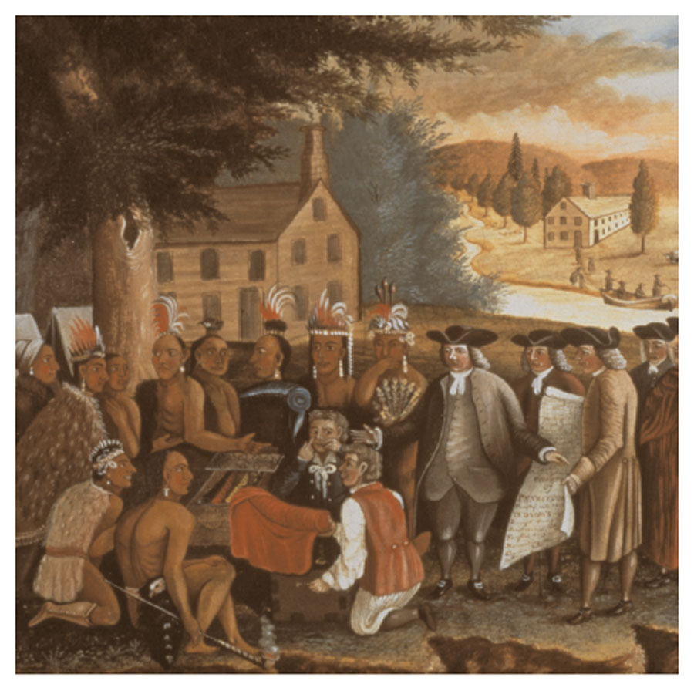
Penn tried to deal with Native Americans fairly; he did not allow colonists to settle on land until Native Americans sold it to them.
During Penn’s lifetime, relations between Native Americans and colonists were much better in Pennsylvania than they were in other colonies.

Slide 13
Control of the Delaware colony passed from the Swedish to the Dutch to the English.
Penn’s charter for Pennsylvania included Delaware, but he gave the colony its own representative assembly.
In 1704, Delaware became a separate colony.

Slide 14
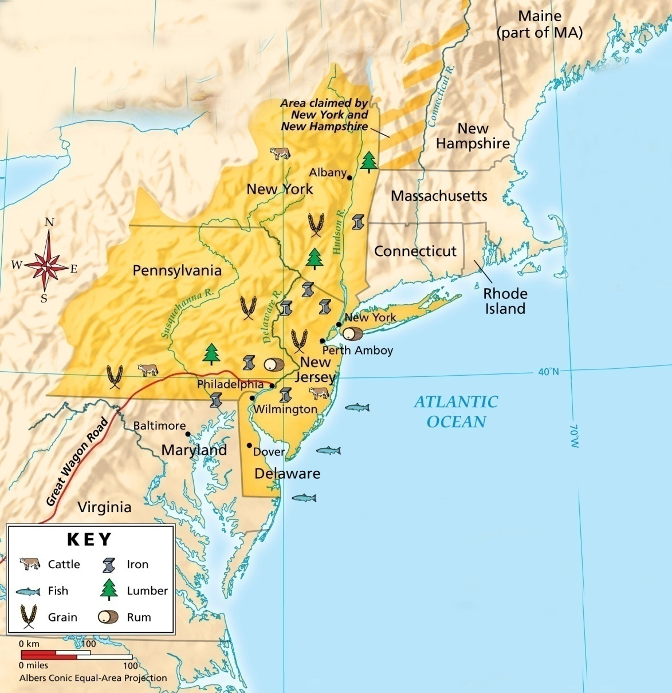
By the early 1700s, more than 20,000 colonists lived in Pennsylvania.
Its wheat farms were productive, and Pennsylvania was called America’s breadbasket.

Slide 15
Manufacturing was just beginning in the Middle Colonies during the 1700s.
Manufacturers produced iron, flour, and pepper.
Town artisans worked as weavers, masons, coopers (barrel-makers), and in many other trades.

Slide 16
By the middle of the 1700s, many settlers were pushing south and west along the backcountry, or frontier, between Pennsylvania and Georgia.
The backcountry settlers that traveled along the Great Wagon Road often fought with Native Americans.
Backcountry Settlers
Native Americans

Slide 17
Many of the people who settled in the backcountry were not English.
Some were Scotch-Irish, and others were German.

Slide 18
By 1750, non-English immigrants had made the Middle Colonies the most diverse part of English North America.
Philadelphia and New York had become the largest cities and busiest ports in the colonies.
All of the colonies had thriving economies.

Slide 19
Section Review
QuickTake Quiz
Know It, Show It Quiz
Notes:
19

