Slide 1
Increasing the Minimum Wage
$
$
$
Dan Havern, Chris Austin, Rabia Jarna, Brooke Juszkowski
American Government – Mr. Kay – 6th Hour
$
$
$

Slide 2
Minimum Wage
The lowest hourly number that employers may legally pay to workers.
Supporters say it increases the standard of living of workers, reduces poverty, reduces inequality, boosts morale and forces businesses to be more efficient.
Opponents say it increases poverty, increases unemployment and is damaging to businesses.

Slide 3
Expert Witness: AFL-CIO
The American Federation of Labor – Congress Industrial Organizations works everyday to improve the live of people who work
Helps people who join together in unions so they can collectively bargain with employers for better working conditions and the best way to get a good job done

Slide 4
Increase the Minimum Wage?
Support an Increase
More productive, stagnant pay
Public support
Help the economy
Cost of living keeps rising
These positive impacts outweigh any negative drawbacks

Slide 5
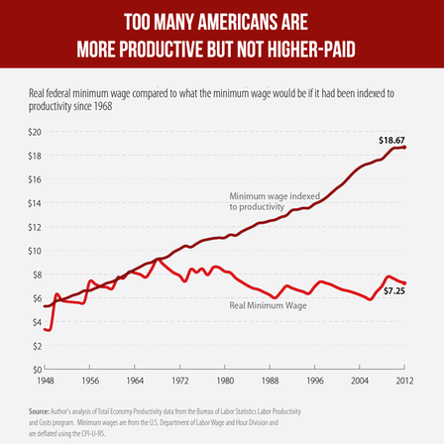
Worker Productivity
Notes:
Compensation for increased productivity

Slide 6
Public Support
4/5 Americans support raising federal minimum wage to above current rate
4/5 economists agree that benefits of raising and indexing minimum wage compensate greatly for any costs

Slide 7
Benefit Economy
Increase consumer spending
From 2007-2009, average yearly increase of 70¢ resulted in an average increase of 1.95 billion dollars in consumer spending
State legislation restricting raise is essentially funneling money to top 1%

Slide 8
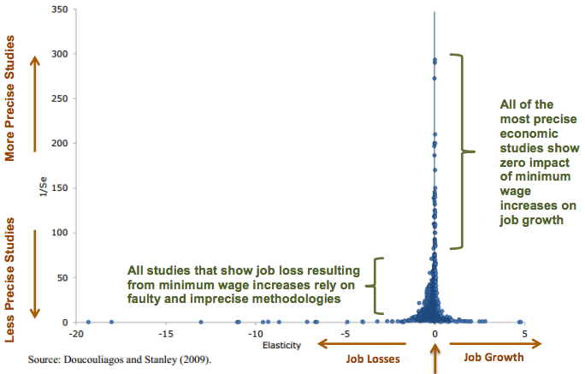
Benefit Economy
Recent studies revealed increasing minimum wage would have positive effect or little to no effect on employment
Stimulated market = increased demands

Slide 9
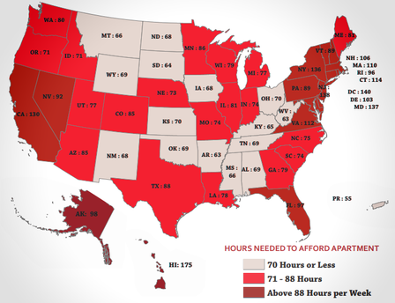
Cost of Living Still Rising
Raise would decrease poverty
Full-time minimum wage worker with two children lives at or below poverty level

Slide 10
H.R. 555 – In the House of Reps.
To amend the Fair Labor Standards Act of 1938 to increase the federal minimum wage
Be it enacted by the Senate and the House of Representatives of the United States of America in Congress assembled,
That this act be cited as the Fair Minimum Wage Act of 2014
Our proposed amendment…

Slide 11
Proposing Our Amendment
Mr. (Madam) Chairman,
I move that H.R. 555 paragraph 1 of section 6a be amended to read:
$7.75 an hour beginning September 1, 2014
$8.25 an hour beginning September 1, 2015

Slide 12
Works Cited
"Minimum Wage." AFL-CIO America's Unions. N.p., 2012. Web. 11 Dec. 2014. <http://www.aflcio.org/Issues/Jobs- and-Economy/Wages-and-Income/Minimum-Wage>.
Aaronson, Daniel, Sumit Agarwal, and Eric French. 2008. The Spending and Debt Response to Minimum Wage Hikes. Working Paper. Chicago, Ill: Federal Reserve of Chicago.
Doucougliagos and Stanely, “Publication Selection Bias in Minimum Wage Research? A Meta-Regression Analysis,”British Journal of Industrial Relations, 2009
Douglas Hall, Ph.D., Director of the Economic Analysis and Research Network at the Economic Policy Institute in Washington, D.C.

Slide 13
Questions?

